Slide 1
Facilitator Guide
MODULE 05: ADVENTURE AWAITS
  It’s time for you to lead Module 5 of “Your Money Adventure” The bulk of this module will be dedicated to an online game and the latter part will allow some time for discussion and reflection about the course and how to move forward.
  You’ll see speaker notes on each slide that read like a script, but we encourage you to ad lib, put it in your own voice, and (*very importantly*) don’t read this word-for-word (that’s a way to lose the teens quick!).
  Sprinkled throughout the speaker notes are bracketed Facilitator Notes that we’ve left for you. These notes offer extra context for the slide, but you should not read those aloud while facilitating.
  We highly recommend you practice each module aloud before delivering it to the teens, especially because there are places where you need to add a personal story/example. This practice will help you connect to the message and deliver it authentically.
  On the next page, you’ll find timestamps for how long each section of the module should take. Keep track as you’re presenting to see if you are too far ahead or behind. If you are, make an adjustment.
  We’ve also found that facilitators who use dual monitors have better engagements during virtual presentations. Put the deck in play mode on your second screen and share that screen. Then, have your speaker notes on your main screen where your camara is. Move the speaker notes to as close to the top of the screen as possible so you can maintain eye contact while presenting.
  Throughout the modules, you’ll be sharing your screen, sending the teens to breakout rooms, using the poll and white board features, and managing the chat. Make sure you are comfortable with all of these interaction tools.
  We know teens can be intimidating but think about how THEY are feeling – finance is intimidating...money is intimidating! Be empathetic to that. Take your time with these concepts and show them this stuff doesn’t have to be as inaccessible as they may think.
  You’re not a regular facilitator, you’re a cool facilitator...WE know that, but teens don’t. They don’t think you’re cool. And that’s ok! Lean into it. Don’t be afraid to geek out a bit. Finance is your jam!
  Start strong. You set the tone for the entire curriculum on day one – really in the first 30 seconds on day one. Especially when you have to delivery virtually, YOU will need to bring the energy to their screens through your voice, your gestures, and your engagement with the material and to the students.
  Every audience, whether they’re adults or teen, will pay more attention to what you say if you to show passion and enthusiasm for the topic you’re presenting on. Tap into the awesome fact that you get to help young people on their road to financial success! Now THAT’S something to get excited about! Let your enthusiasm and excitement be infectious! It will carry you a long way.
  Hide or delete the facilitator guide before facilitating the module.

Slide 2
Facilitator Guide
MODULE 05: ADVENTURE AWAITS
  Here are recommendations
  to set you up for success:
  Becoming familiar with the game
  Take yourself through the game at least two times before facilitating this module. That way, you’ll know how the game is unfolding and which parts of the game are context vs direction for the teens.
  You may even want to recruit your friends and colleagues to do a test run where you facilitate as they play before you jump into Module 5 with the teens.
  The game was written with a gender neutral name of “Taylor,” but we’ve used the pronouns “she/her” in the speaker notes since we used “Marcus he/him” in the previous module.
  Setting up the game
  Before beginning this module, have the link open and ready to go in your browser. Click through, beyond the opening context (we’ve included the context in speaker notes for you to share before you start playing the game with the teens). You want to land on the salary question, and then leave your browser open to that screen.
  Play around with the browser screen size. It’s ideal to have just the game questions and stats, so shrink the window until the left-hand menu (where it says restart game, about this game, etc) disappears.
  Speaking of sharing your browser, during the module you’ll go from sharing your slides to sharing your browser window. Make sure Five Money Musts is the only tab you have open and that you just share your browser, not the whole desktop.
  The game unfolds like a story, and that makes you the storyteller. Each time you get to a screen with a question, you’ll ask the teens to vote for the option that the main character should take by typing their choice in the chat.
  Most questions have three options, so make option one A, option two B, and option three C.
  If there are only two options, make option one A and option two B.
  There is one question that asks teens to determine which expenses, from a list of expenses, Taylor should include in her budget. For this question, it’s too hard to have them vote. Instead, give the teens a minute to look at all the expenses and decide for themselves whether or not they’d include it in Taylor’s budget. Then, tell them for each expense, you’ll ask one teen to unmute and share. If you want to ignite a conversation about the expense, you could ask someone else if they agree or disagree. Don’t engage in conversation around each expense, though, as it will take up too much time.
  There’s another question that involves 401K contributions and allows you to move a slider bar between 0 and 20% of the budget, and to consider an employer match. Take a minute or two to play around with the toggle and show them how the total contribution changes before inviting them to weigh in. Then, give them four choices: A is 0%, B is 7%, C is 15%, D is 20%.
  Your job is to reinforce concepts after they’ve locked in their answer to each question and seen how the choices impacted Taylor’s money and happiness. Make connections to what they learned in Module 2 with statements like “Ah, see how not getting a credit card means Taylor has no credit history…remember we talked about smart ways to use credit last week…onto the next questions!”
  Ultimately, we want this to be an empowering game for participants. We hope they’re pleasantly surprised at how much they know already ☺ And hey, if there are missteps, they can learn from Taylor’s mistakes.
  This game will need to be complete by the 35 minute mark of your hour-long class (at the latest). Should you find yourself falling behind, you could skip majority rule and say “I’ll go with the first response I see in the chat”, or call on someone for their answer, or you could breeze past the summary pages in the game.
  Money Musts Guide
  For the bulk of this module, you’ll be facilitating Fidelity’s 5 Money Musts game while students play along. You can find the link here: https://digital.fidelity.com/prgw/digital/five-money-musts#/home
  The game invites teens to make financial decisions for their family friend Taylor who just graduated college. Each choice impacts her financial future, as well as her happiness. Even though you’ll see less speaker notes for this section of the deck, you’ll still have a lot of speaking to do as you guide the teens through the game, ask them questions about their answers, and sprinkle in the tips and context you shared with them in Modules 2, 3, and 4.

Slide 3
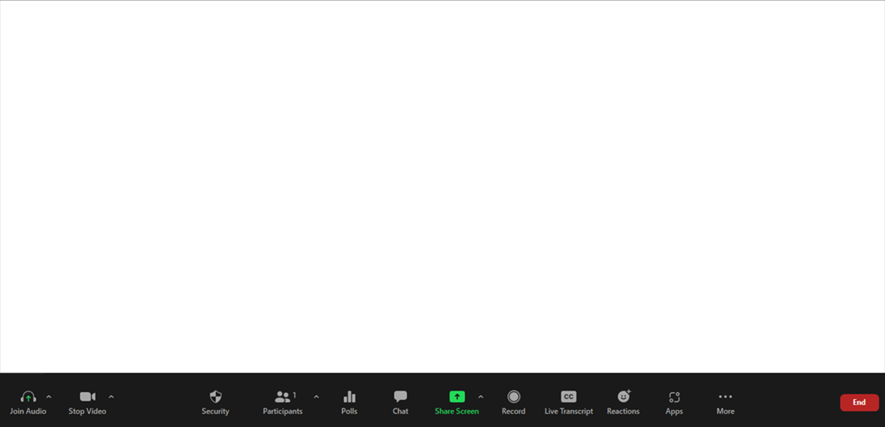
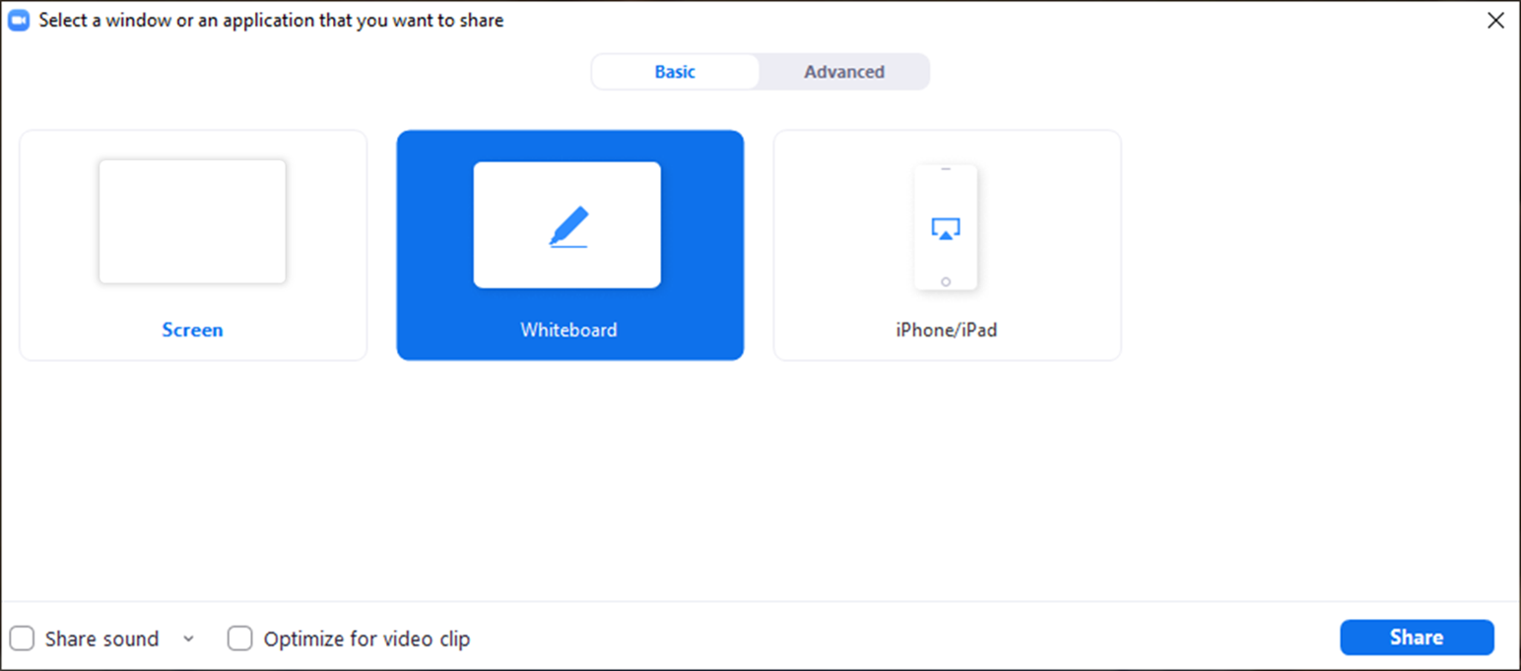
Facilitator Guide
MODULE 05: ADVENTURE AWAITS
  Tech Considerations:
  Whiteboard
  Using the Whiteboard: To use the whiteboard function in zoom you select “Share Screen” and then select the “Whiteboard” option in the pop up. Once the whiteboard opens select “Text” and you will be able to type directly onto the whiteboard.

Slide 4
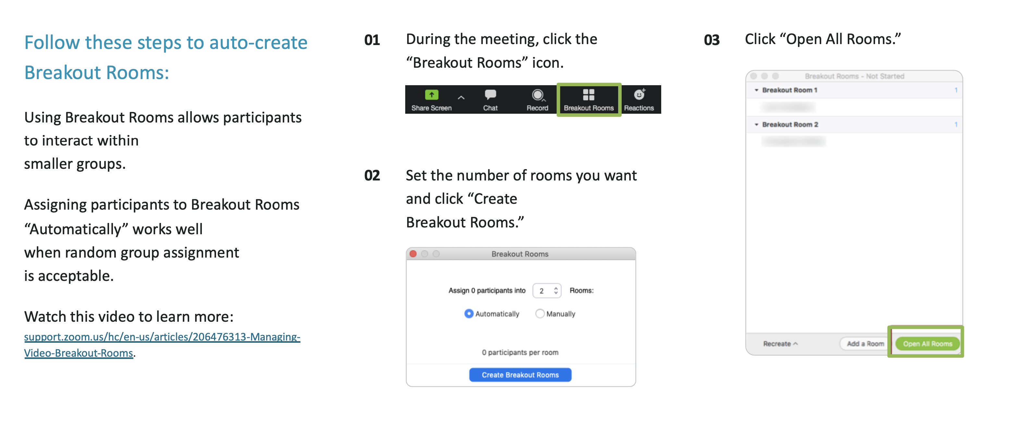
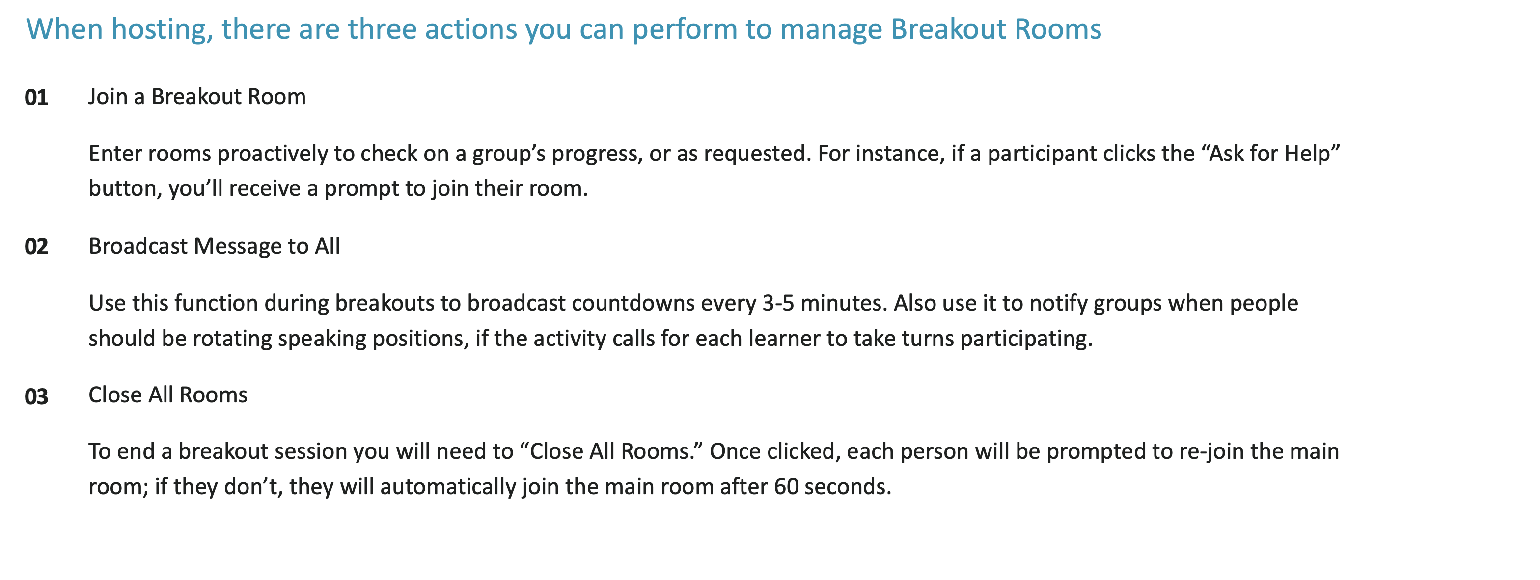
Facilitator Guide
MODULE 05: ADVENTURE AWAITS
  Tech Considerations:
  Breakout Rooms
  In order for breakout rooms to be enabled you have to be the host of the meeting. So that’s the first step, make sure you are assigned as the host or the co-host of the session.
  Assign 4 students per room with a minimum of 3 students if necessary.

Slide 5
Timing Breakdown
MODULE 05: ADVENTURE AWAITS
Section | Duration |  | Section | Duration
Introduction: Welcome back | 1 min |  | Debrief | 2 min
Icebreaker – Quick check in | 3 min |  | Course Wrap Up: Think and share: Clear path forward | 5 min
Review | 1 min |  | Close: Knowledge check | TBD
Choose Your Friend’s Adventure: Intro to game + This is Taylor + Gaming logistics | 2 min |  | Achievement unlocked | 1 min
5 Money Musts | 30 min |  | Facilitator Close | TBD

Slide 6

Welcome!
I’m excited
you’re here!
01 Camera on if you can
02 Mic on mute until
you're ready to share
03 Grab a pen and paper
or open a new document
Notes:
[Facilitator note: Log on a few minutes before the start of the module. As students are joining the Zoom, you’ll want to give them instructions of how to prepare. This moment of interaction will both save time later and create an engaging/inviting atmosphere]
Welcome back everybody! If you can, we’d love to have you on camera for this workshop and your mic on mute until it’s time to share! [Facilitator note: It’s best to make “camera on” optional and not try to pressure students to come on camera]
While you’re getting settled in, make sure to have a pen and paper handy, or open a new document on your device. We’ll be doing a few exercises today where you’ll need to write out your answers.

Slide 7

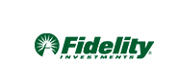
Education Content Created By
Your Money Adventure
05 Adventure awaits
Speaker Name | Speaker Title
Date
Notes:
We’ve made it. It’s the final week of our financial journey and you’ve come such a long way! It has been quite an adventure and I consider myself lucky to have taken this journey with you.
But before I send you off on your next adventure, we’ve got some important final things to cover.

Slide 8


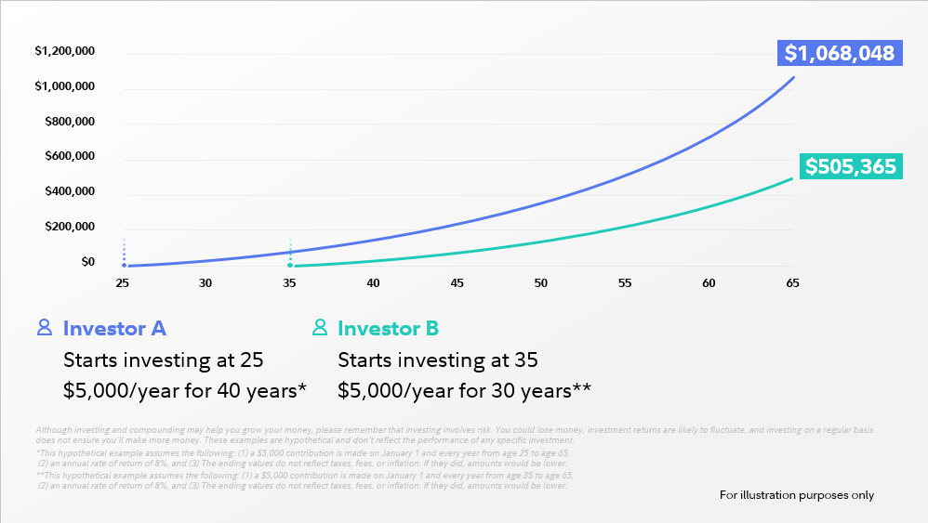
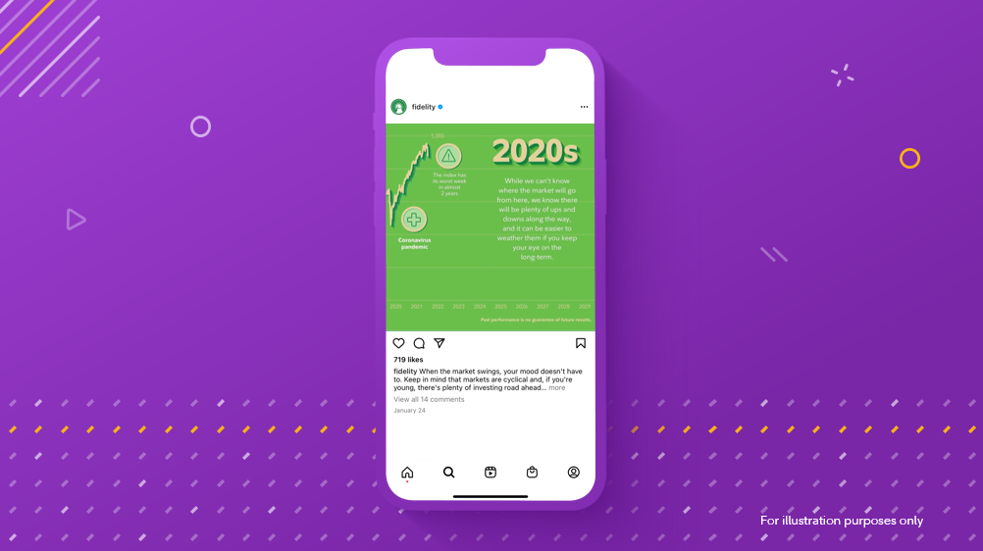


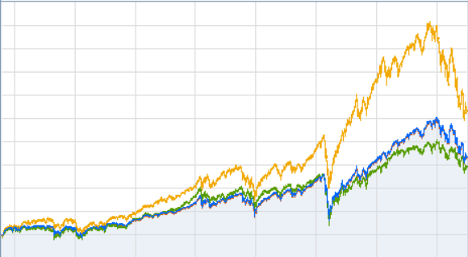
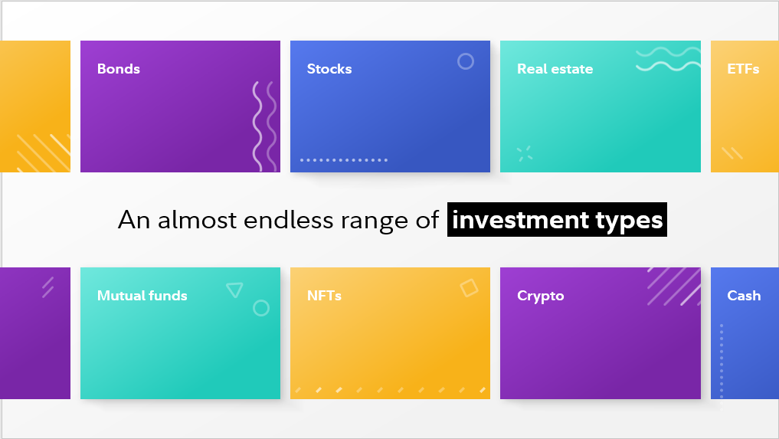
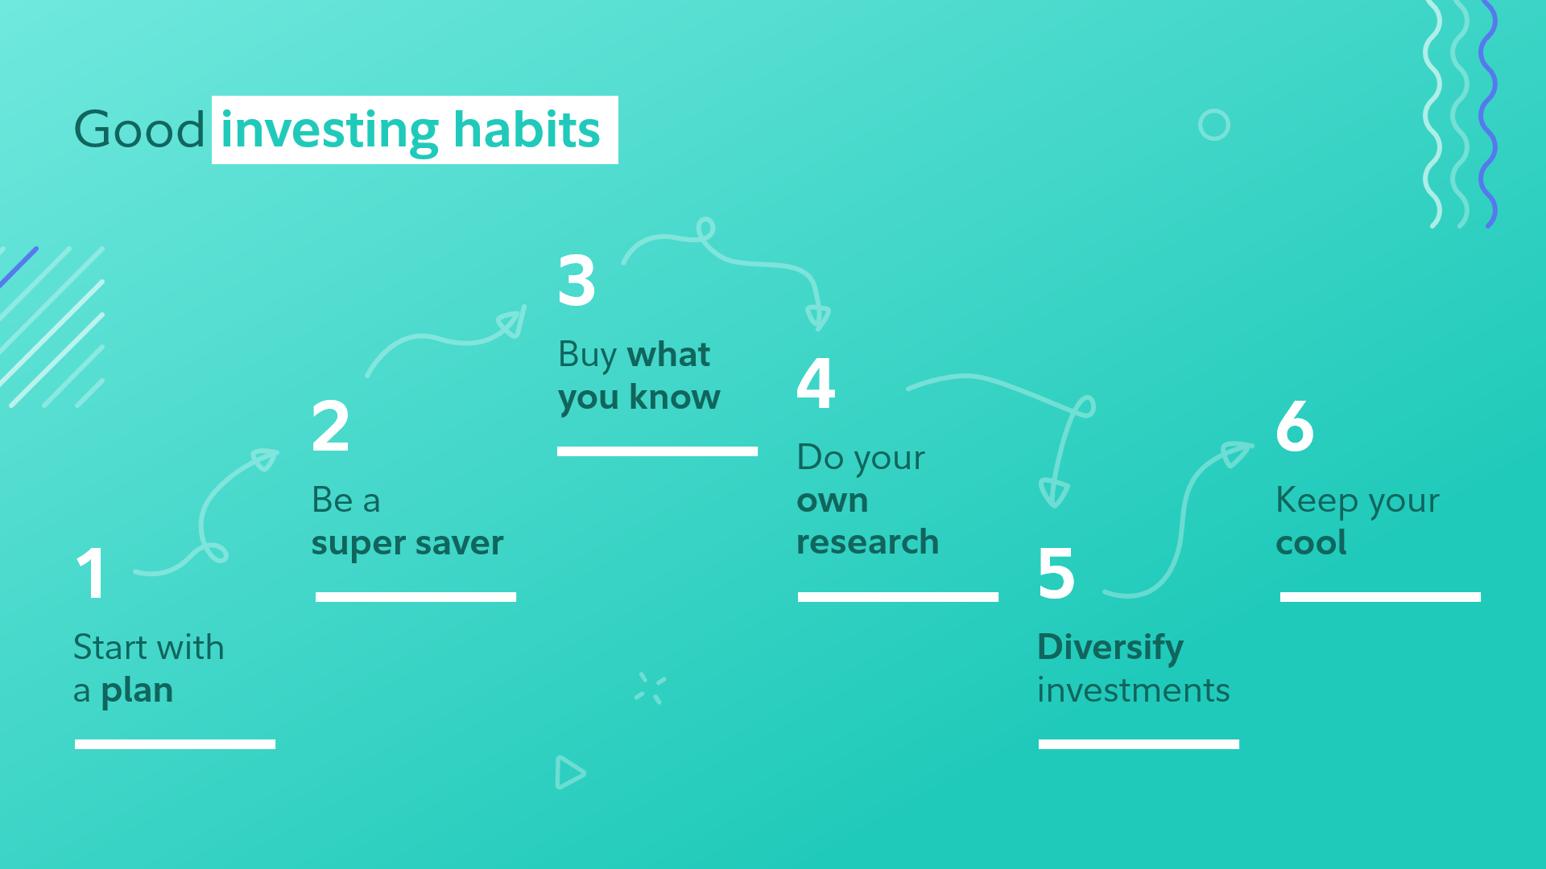
What questions, thoughts, ideas
do you have about investing?
For illustrative purposes only
Notes:
First, I want to check in with you. We covered a lot last week so I want to spend a few minutes today covering any questions or things you’re curious about when it comes to investing that may have come up for you. So what questions, thoughts, ideas (whatever!) about investing have bubbled up for you since last time? (e.g. Where does compound interest come from? If questions come up about specific securities, taxes, etc. you might want to ask a professional)
[Give them time to answer. This is a quick ice breaker so spend about 3 minutes here. If no one answers you could pose another question have them pop a response into the chat – “Let me ask you a different question then. Pop your answer in the chat. What excites you most about investing? Or What would hold you back from investing?” Respond to these as they come up; share in their excitement and help address their concerns]
These are [good questions/important considerations]. I hope you’ll continue to explore and question and stay curious about money and finances beyond our time together in this class.

Slide 9





05
01
Build your roadmap
Strategy for spending smart
Adventure awaits
Financial know-how in action
Let the adventure begin
Short-term / long-term goals
Lay of
the land
Savvy saving habits
Boost
your plan
Jump into investing
Notes:
And boy have we had a time! Look at the adventure we’ve shared!
We started by thinking in terms of goals: the adventures we envisioned for ourselves and the things we hope to save for.
Then we focused on becoming savvy savers...and spenders.
And together, we learned the basics of investing.
Today we’re going put all this new knowledge into action...

Slide 10

FIVE
MONEY
MUSTS
Notes:
So let’s begin! Today we’re gonna play a game we call Five Money Musts!
The game where real life and money meet. And you are in charge of how it all shakes out. Ya’ll ready for a little game play?!
Great! First, a little background info and some rules of the game...

Slide 11








For illustrative purposes only
Notes:
This is Taylor.
She’s a close family friend, fresh out of college, and the real world is comin’ in hot. She’s got bills to pay, student loan debt to pay off, and fun to have! She wants to do it all but be smart about it.
[Facilitator note: the game actually says Taylor is your friend, but we’re not sure 13-year olds need 22 year old friends, so we’ve added the word “family friend” to your intro of Taylor and the game].
She’s overheard you talking about what you’ve been learning over the past few weeks and needs your help.
So today, equipped with everything you’ve learned in this course, you’re all going to help Taylor make some smart money choices. Choice is the name of this game and Taylor will have LOTS of choices to make.
I’m going to walk you through a series of choices and you’ll decide what Taylor should do by selecting option A, B, or C and putting your answer in the chat. And remember, there's isn't always ONE right choice when it comes to money. The choices you make have tradeoffs. Sometimes I’ll ask people to come off mute and share their choice because it’s too complicated to vote—you’ll see what I mean when we get there.
The majority rules in this game, so we’ll go with the most popular choice, but whatever choice you make along the way, be ready to share your thinking with us. I want to hear from everybody!

Slide 12

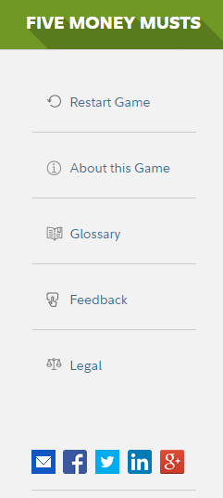
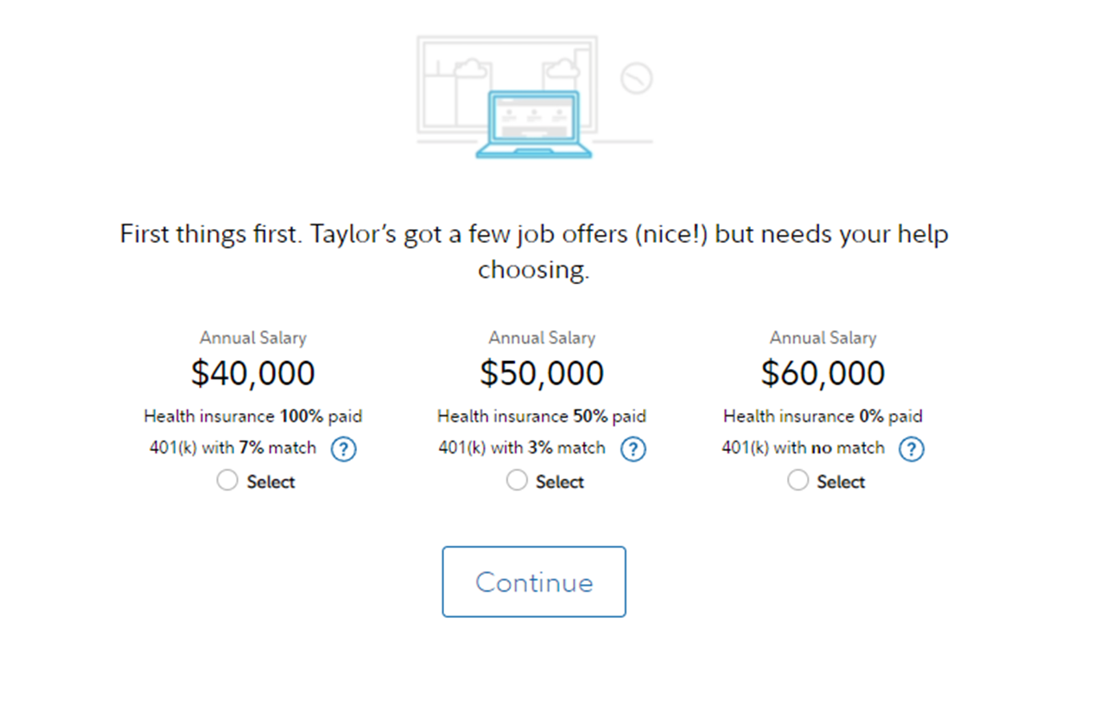
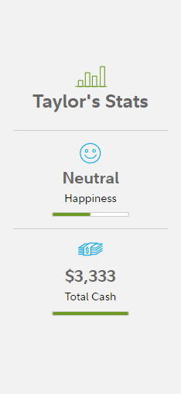
Taylor’s Stats
Help Taylor make smart money choices.
Choose an option below.
Neutral
Title
Title
Title
Happiness
Option A
Option B
Option C
Subtext
Subtext
Subtext
$$$
Total Cash
817536.6.0
For illustrative purposes only
Notes:
In just a minute we’ll jump into the game, but I want to draw your attention to Taylor’s stats on the right-hand side of our gaming screen.
First, just below the smiley face you’ll see Taylor’s happiness score. It’ll go up and down with each choice you make, so try not to let it get too low.
Below that is Taylor’s cash meter, which shows how much money is left for the month. Make sure there’s enough to cover what she needs (AND some extra so she can have a little fun). Let’s try to help her make it through the month without blowing it all.
As always, if you have questions at any point, don’t be afraid to come off mute. If you’ve got a question others will too, so I want to hear from you.
Are you ready to play? Great! Let me stop sharing for a second and pull up our game.
[Facilitator note: switch to the browser with the first question of the game displayed and share. https://digital.fidelity.com/prgw/digital/five-money-musts#/home]

Slide 13
Notes:
Alright! For question number one…
Let’s look at this dashboard to see how our recommendations for Taylor played out.
[Facilitator note: recap what you see in the dashboard, calling out great decisions they made along the way and places where their decisions might have cost them something in the long term…]
[Facilitator note: On the last screen of the game, under “Final Score” and “Play again?” there is information on investing that does not pertain to teens. Please focus on the results score to see how Taylor made out. If the kids ask about the other products, then tell them they are for adults or people like Taylor.] (Five Money Musts eReview number: 817536.6.0)
[slide intentionally left blank]

Slide 14

Notes:
[Facilitator note: If you haven’t reached the 35 minute mark of the session yet, you could pose a few questions: How was that? What did you think? What choices do you wish you had that weren’t available to you in the game? (e.g. “I wish there was an option to set aside a certain dollar amount. Or I wish we had the option to do coffee instead of an expensive dinner to save money”)]
That was a fun game, right? There are so many directions Taylor could have gone and each choice leads her down a different path. You may have noticed a few places where some answers were better than others, but it was also important for us to consider where Taylor is in life and what her priorities might be. If you’re curious to see how the answers you picked might have changed things, I’ll pop the link in the chat so you can play it on your own.
Like I said at the start, choice is the name of this game. And that’s true for you as well. When it comes to money, you are faced with choices DAILY. And not to sound dramatic or anything, but the choices you make today can truly impact your life tomorrow. So that knowledge you now have won’t just help Taylor, but it can help you as well.
[If they did pretty well in the game] I mean, everybody’s feelin pretty good about their money skills after that game, right? That was amazing! It was awesome to watch you lead Taylor through her choices! But enough about Taylor, let’s talk about you.

Slide 15

1
What’s your
biggest takeaway
from this class?
2
  What will you start
  doing differently?
Notes:
I hope that game really helped show you just how far you’ve come in such a short amount of time. You’ve got a ton of new knowledge in your tool kit and I want you to use it well beyond what we’ve done together in this course.
With that in mind, I want you to take a little time to reflect on these two questions: What’s your biggest takeaway from this class? (going back to the beginning and not just today) What’s something you might start doing differently as a result of what you learned here?
I’m gonna give you two minutes to write your response on a piece of paper or in a word doc so you can share with the group when you’re done with the reflection. Any questions?
[2 min reflection]
Alright...I’d love everybody to pop their response in the chat and it would be great to hear from a few of you! [Facilitator note: here’s an opportunity to get some qualitative feedback from all students, so that’s why the chat, but this should be an opportunity for discussion so try to engage them and get them to come off mute to share].

Slide 16



You’ve finished this
session and earned a
finance wiz pin!
5 / 5
completed!
You collected them all!
Notes:
Is there anything you would like to mention or ask as we wrap up the course?
You did it! You’ve earned the last pin in our adventure series and put your financial know-how into action.
I hope you’ll keep taking steps to move you well beyond the adventure we’ve shared here and into a future of financial stability, and freedom.

Slide 17
01
Build your roadmap
Strategy for spending smart
Adventure awaits
Financial know-how in action
Let the adventure begin
Short-term / long-term goals
Lay of
the land
Savvy saving habits
Boost
your plan
Jump into investing
Notes:
There’s so much more to explore and this is only the beginning...

Slide 18

Investing involves risk, including risk of loss.
Views expressed are as of the date indicated, based on the information available at the time and may change. Unless otherwise note, the opinions are those of the speaker and not necessarily those of Fidelity Investments.
Fidelity Brokerage Services LLC, Member NYSE, SIPC, 900 Salem Street, Smithfield, RI 02917
© 2022 FMR LLC. All rights reserved.
1024860.3.0
Notes:
[If there’s time left at the end, can open it up to questions]

