Slide 1
Facilitator Guide
MODULE 03: BUILD YOUR ROADMAP
  It’s time for you to lead module 3 of “Your Money Adventure.” As you know, we built modules 2 and 3 to complement each other. Module 2 introduced expenses, spending, and saving, but was largely focused on saving while Module 3 focuses on smart spending.
  Continue to encourage some participation from teens you haven’t heard from yet.
  As is always the case, if you have time at the end, open up the floor to questions and discussion. Maybe they’ll have questions about what you covered or questions about things coming up in the modules.
  You’ll see speaker notes on each slide that read like a script, but we encourage you to ad lib, put it in your own voice, and (*very importantly*) don’t read this word-for-word (that’s a way to lose the teens quick!).
  Sprinkled throughout the speaker notes are bracketed Facilitator Notes that we’ve left for you. These notes offer extra context for the slide, but you should not read those aloud while facilitating.
  *We highly recommend you practice each module aloud before delivering it to the teens, especially because there are places where you need to add a personal story/example. This practice will help you connect to the message and deliver it authentically.
  On the next page, you’ll find timestamps for how long each section of the module should take. Keep track as you’re presenting to see if you are too far ahead or behind. If you are, make an adjustment.
  We’ve also found that facilitators who use dual monitors have better engagements during virtual presentations. Put the deck in play mode on your second screen and share that screen. Then, have your speaker notes on your main screen where your camara is. Move the speaker notes to as close to the top of the screen as possible so you can maintain eye contact while presenting.
  Throughout the modules, you’ll be sharing your screen, sending the teens to breakout rooms, using the poll and white board features, and managing the chat. Make sure you are comfortable with all of these interaction tools.
  We know teens can be intimidating but think about how THEY are feeling – finance is intimidating...money is intimidating! Be empathetic to that. Take your time with these concepts and show them this stuff doesn’t have to be as inaccessible as they may think.
  You’re not a regular facilitator, you’re a cool facilitator...WE know that, but teens don’t. They don’t think you’re cool. And that’s ok! Lean into it. Don’t be afraid to geek out a bit. Finance is your jam!
  Start strong. You set the tone for the entire session on day one – really in the first 30 seconds on day one. Especially when you have to delivery virtually, YOU will need to bring the energy to their screens through your voice, your gestures, and your engagement with the material and to the students.
  Every audience, whether they’re adults or teen, will pay more attention to what you say if you to show passion and enthusiasm for the topic you’re presenting on. Tap into the awesome fact that you get to help young people on their road to financial success! Now THAT’S something to get excited about! Let your enthusiasm and excitement be infectious! It will carry you a long way.
  Hide or delete the facilitator guide before facilitating the module.

Slide 2
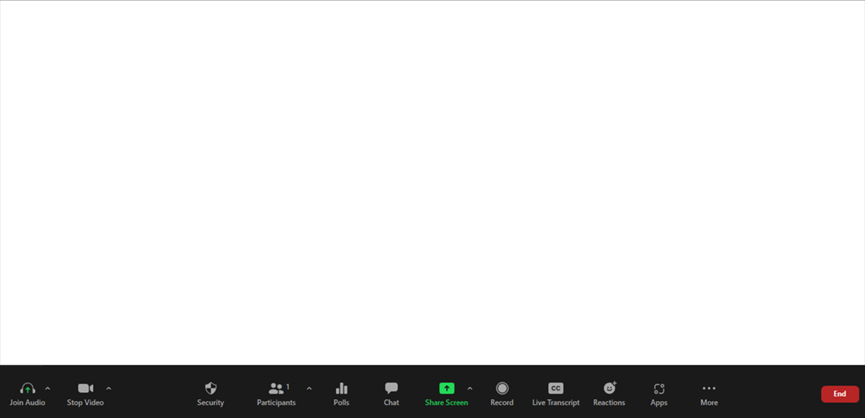
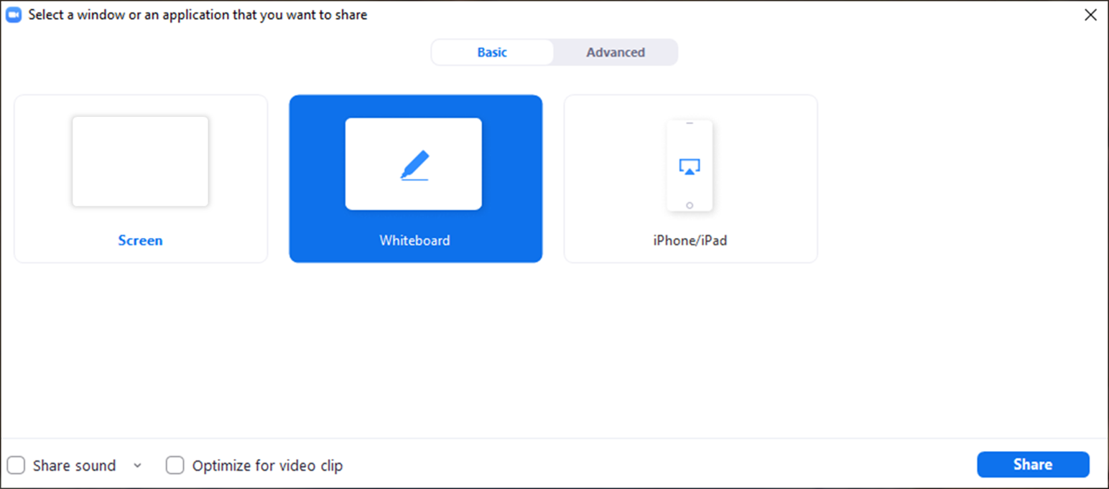
Facilitator Guide
MODULE 03: LAY OF THE LAND
  Tech Considerations:
  Whiteboard
  Using the Whiteboard: To use the whiteboard function in zoom you select “Share Screen” and then select the “Whiteboard” option in the pop up. Once the whiteboard opens select “Text” and you will be able to type directly onto the whiteboard.

Slide 3
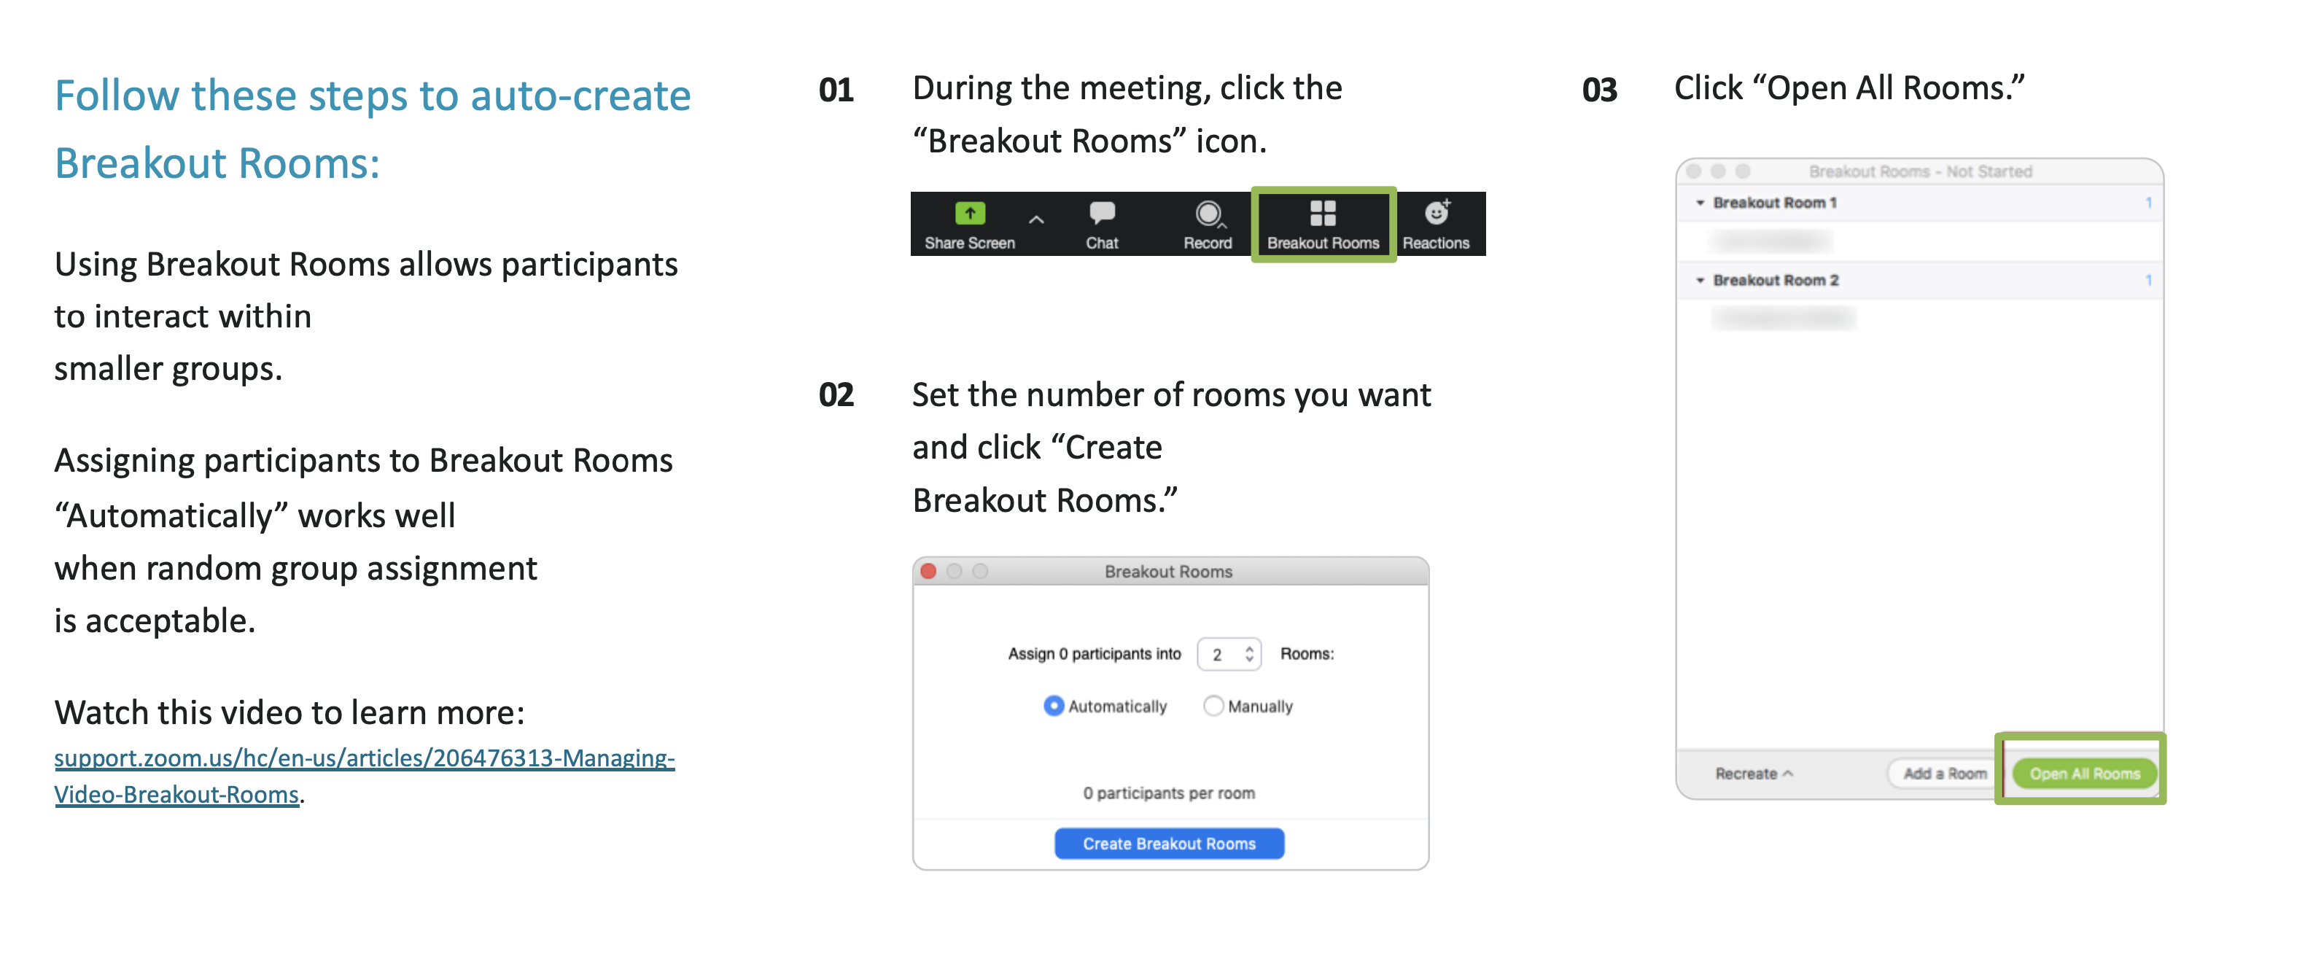
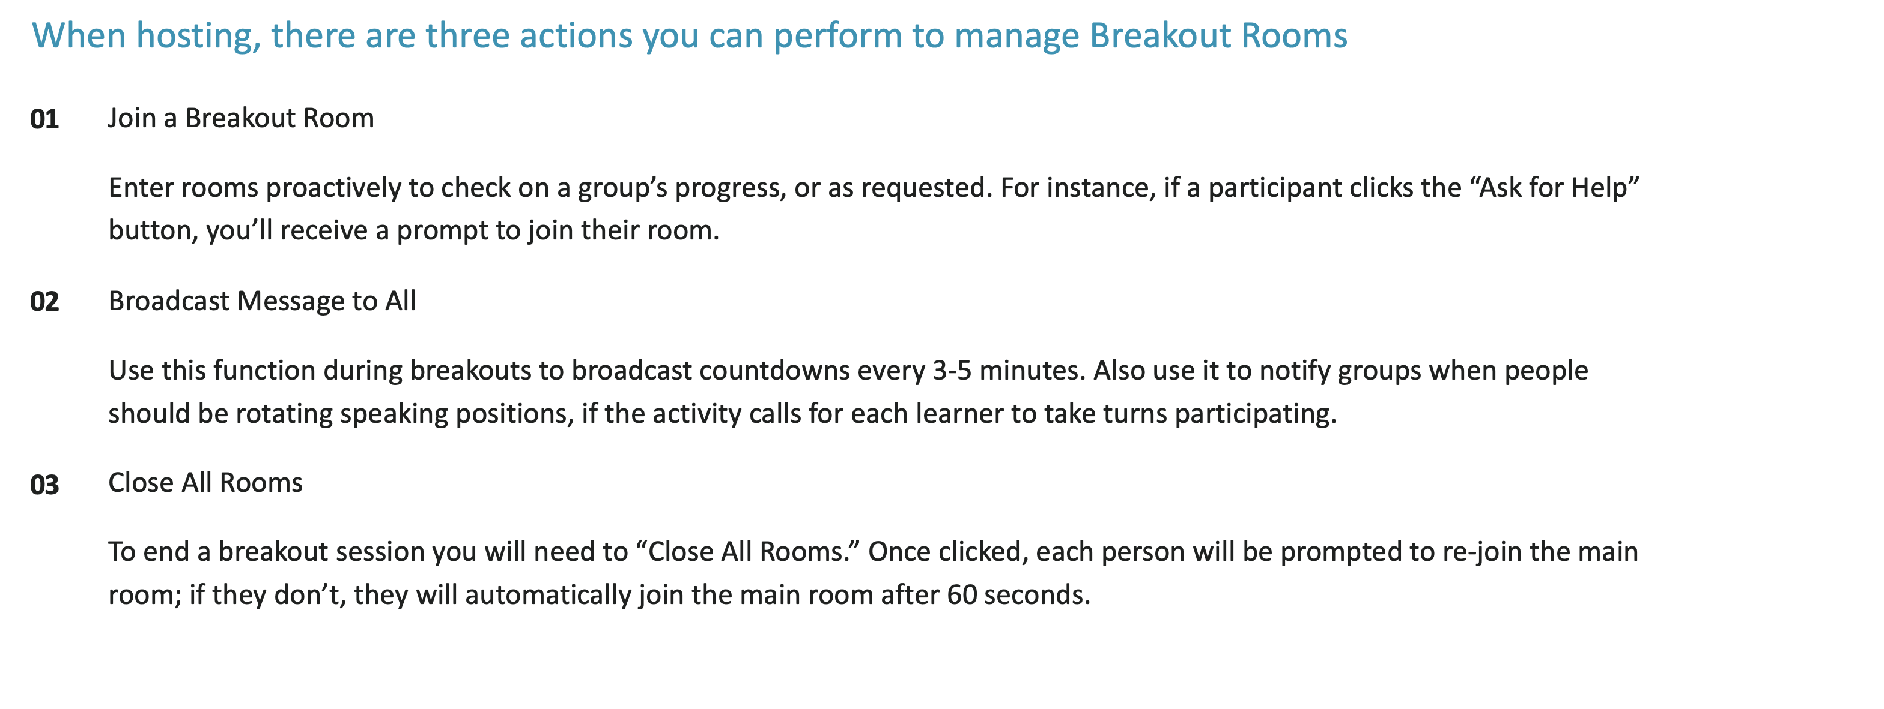
Facilitator Guide
MODULE 03: LAY OF THE LAND
  Tech Considerations:
  Breakout Rooms
  In order for breakout rooms to be enabled you have to be the host of the meeting. So that’s the first step, make sure you are assigned as the host or the co-host of the session.
  Assign 4 students per room with a minimum of 3 students if necessary.

Slide 4
Timing Breakdown
MODULE 03: BUILD YOUR ROADMAP
Section | Duration |  | Section | Duration
Welcome back + Did you explore more | 5 min |  | What is a credit score and why is it important | 1 min
Recap & intro + Guess the price | 7 min |  | Two friends | 13 min
Spend only what you have: Cash | 1 min |  | Loans + Payday loans | 2 min
Credit cards | 2 min |  | Guess the price: Tablet edition | 5 min
The power of compound interest: The compounding penny | 2 min |  | Achievement unlocked + Close + Explore more | 8 min
The power of compound interest: friend and foe + Credit card example | 5 min

Slide 5

Welcome!
I’m excited
you’re here!
01 Camera on if you can
02 Mic on mute until
you're ready to share
03 Grab a pen and paper
or open a new document
Notes:
[Facilitator note: Log on a few minutes before the start of the module. As students are joining the Zoom, you’ll want to give them instructions of how to prepare. This moment of interaction will both save time later and create an engaging/inviting atmosphere]
Welcome back everybody! If you can, we’d love to have you on camera for this workshop and your mic on mute until it’s time to share! [Facilitator note: It’s best to make “camera on” optional and not try to pressure students to come on camera]
While you’re getting settled in, gather any notes you took last week. As usual, have a pen and paper handy, or open a new document on your device. Today we’re putting all of our hard work over the past few weeks into action.

Slide 6


Education Content Created By
Your Money Adventure
03 Build your roadmap
Speaker Name | Speaker Title
Date
Notes:
Welcome back everybody!
Today we’re jumping right in because we’ve got lots of fun ahead of us. I want to make sure we take advantage of all the time we have together today.
But first I want to hear from you...

Slide 7
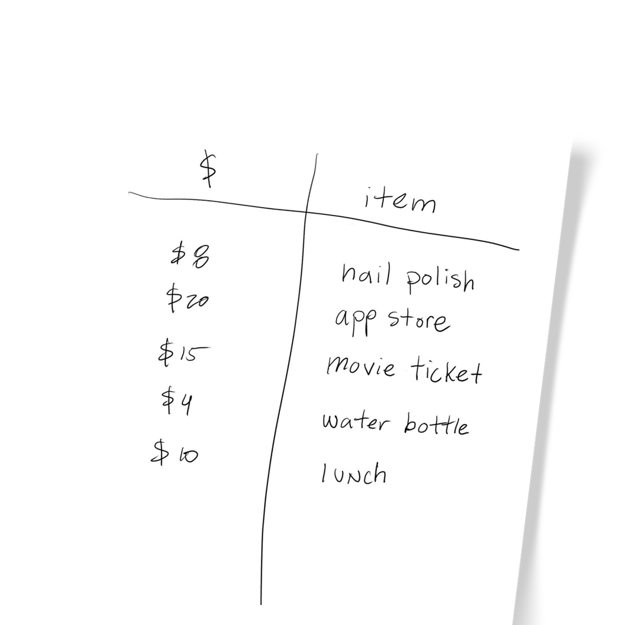
Explore
more!
Track your
spending this week
Notes:
We ended last week asking you to keep track of what you spend or to pay attention to how much the things around you cost.
Did anyone get a chance to do this?
[Facilitator note: wait to get some feedback]
[If they answer YES - Was anyone surprised at what you saw? Were prices higher than you thought? Lower? Maybe you thought you spent less during the week, for example, on food and when you added it up you thought “Uggghhhh, that might be a place to cut back.” Keep track because each week is going to vary because some weeks you’ll pay for gas and other weeks you’ll have something like a yearbook fee. The goal for now is just to get a better sense (on average) of what your costs are each month.]
[If no one did it- Maybe you didn’t get a chance to or maybe you didn’t spend any money this week so the prompt didn’t apply to you yet.]
If you didn’t get a chance to do it this week, I encourage all of you to start tracking your expenses or becoming more mindful of daily expenses and costs in general; it’s a great habit to get into. Not only will it help you develop a smart spending and saving plan, but staying on top of these things will help you take care of your needs and hopefully have a little fun with your wants. At the end of the day when it comes to finances, knowledge = power.

Slide 8



03
05
01
Build your roadmap
Strategy for spending smart
Adventure awaits
Financial know-how in action
Let the adventure begin
Short-term / long-term goals
04
Lay of
the land
Savvy saving habits
Boost
your plan
Jump into investing
Notes:
Last week we talked about being smart spenders and savers. We learned about different ways of saving so we can save towards our goals.
And when it comes to spending we talked about the difference between needs (including putting money aside for our savings) and wants.
As we noticed with Trey’s scenario last week, part of being able to set money aside for savings is about being a smart spender. So we’re gonna focus our efforts there today.

Slide 9





Guess the price!
New sneakers
One-bedroom apartment
in Brooklyn
$100
$3,080
Monthly
phone bill
Monthly groceries for one
Takeout for
2 delivered
$340
$70
$27
For illustrative purposes only
Notes:
Now let’s not forget, part of the joy of earning money is getting to spend it, so let’s have a little fun. We’re going to play a little game of Guess the Price.
I’m going to put an item on the screen, and I want 3 people to guess the price and type it into the chat. The person who is the closest, wins! But, the trick is that you can’t guess MORE THAN the price, or you’re automatically out. I have 5 different items for you to guess the price, so I’ll need a different group of 3 people each time. And I’m only giving you 5 seconds to come up with an answer—no searching online!
Who are my first 3 volunteers?
[Facilitator note: after the first item and price guesses, show the answer, congratulate the winner, and then ask for the next 3 volunteers. Repeat the process with each item].

Slide 10
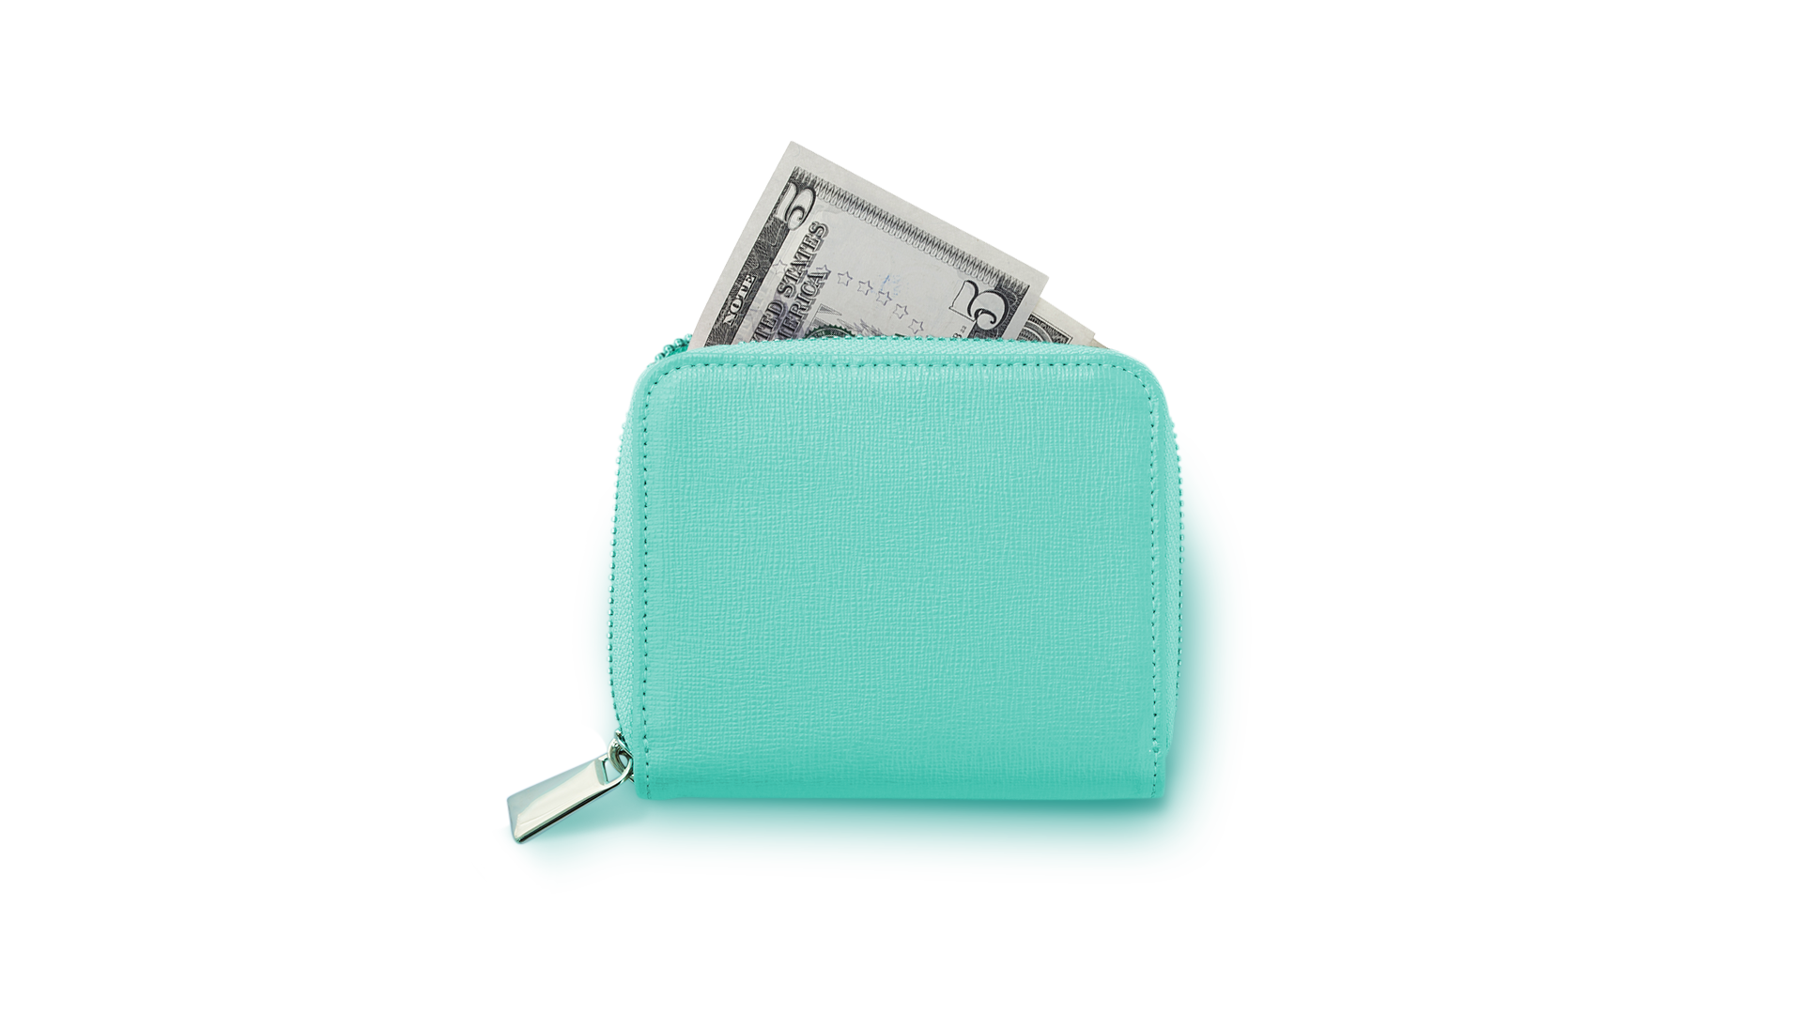
CASH
  Spend only
  what you have
  Includes physical cash or money in a bank account
Notes:
I hope I’ve made it clear so far that spending money is NOT a bad thing! Obviously we need to spend money to live, and spending money can sometimes improve our health, happiness, or even set us up to have more money in the future. There are benefits to spending money when we do it smartly.
So let’s start with spending cash, either paper money or directly from your bank account using a debit card or check.
When you spend the money you know you already have, it’s easier to make sure you don’t overspend. After all, you can’t buy that $50 coat if you don’t have the $50 yet.
And when you spend cash, you know right away that it’s gone. There was $125 in your bank account, and the moment you swiped that card or tapped your phone to pay for a coffee or a breakfast sandwich, the total in your account is down to $120.
But there are some drawbacks to only spending cash. It can take a long time to save up enough cash for something like a new computer you might need for school. But you might know that new computer is going to help you work faster, which means you can take on more hours at your part-time job.
This is where buying with credit could come into play.

Slide 11
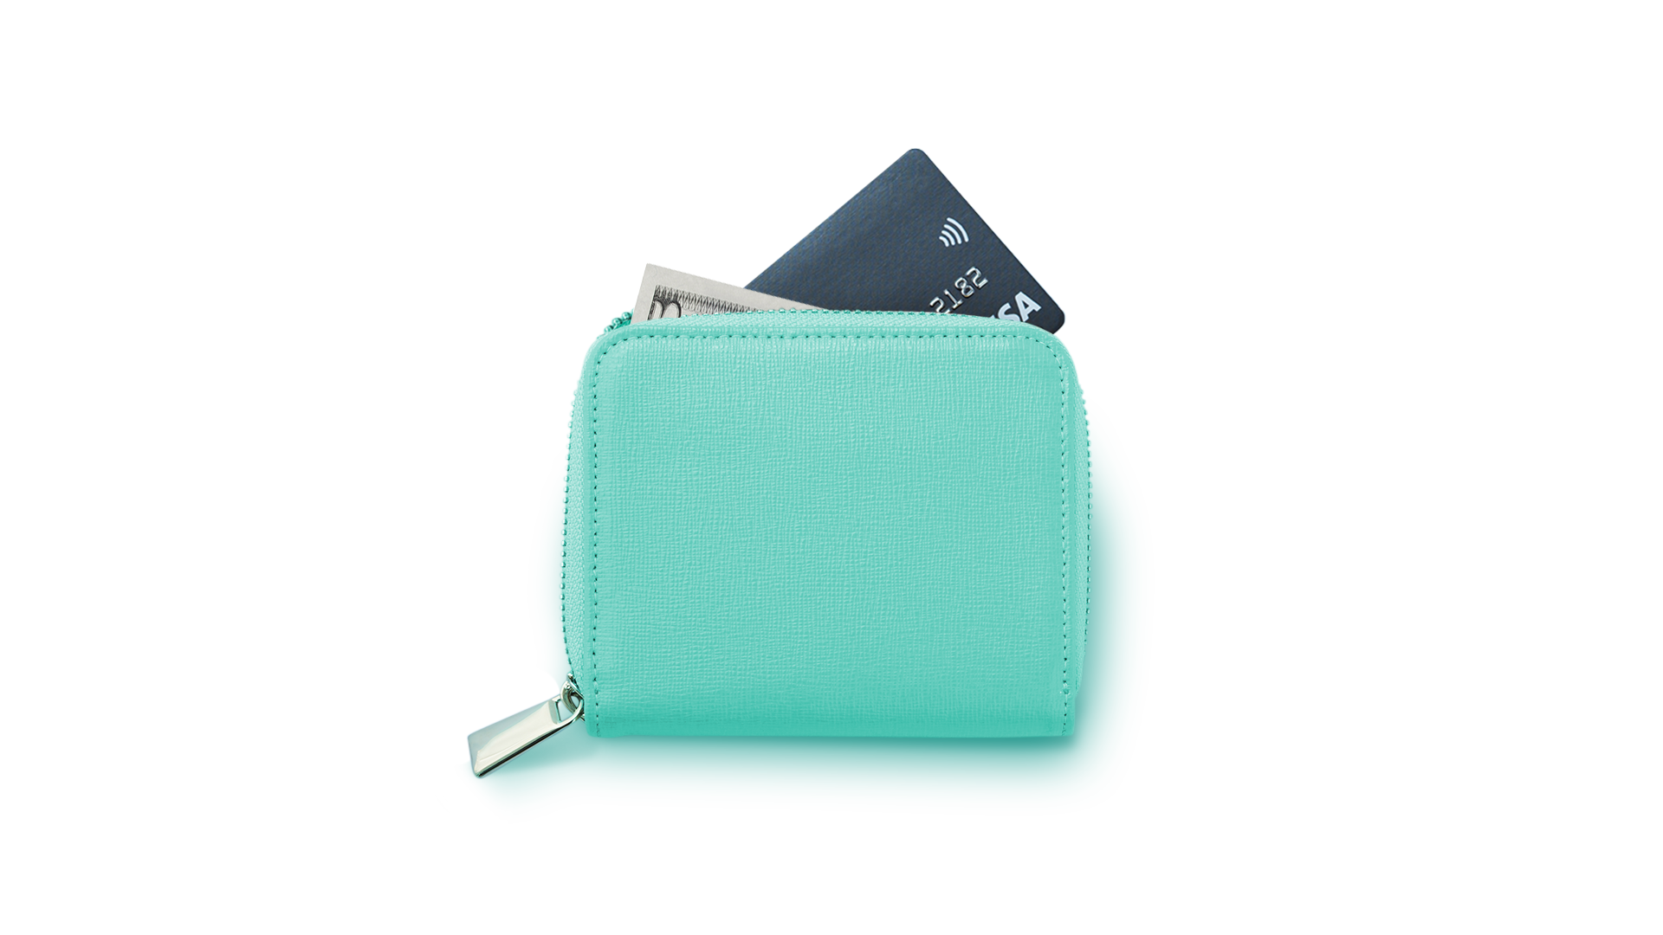
CREDIT
CASH
  Borrowed
  money you
  pay back
  with interest
  Paying off the entire
  balance monthly will
  not accrue interest
  Spend only
  what you have
  Includes physical cash or money in a bank account
Notes:
Normally credit cards are reserved for adults, or an adult can help you get a credit card. So you might not have one for a few years, but we want to talk about them now.
You’ve probably been warned about credit cards, and for good reason. While they can help you purchase something you may not have the money on hand for, they can also be a slippery slope into debt. So in the end, something that only costs $50 might end up costing you a lot more.
When you use a credit card, you’re borrowing money from the credit card company. And they are very happy to lend it to you—for a fee. The fee you pay comes from the “interest rate.”
The way it works is that every month you put expenses on your credit card, the credit card company takes the total and multiples it by a percentage—the interest rate. Then, they add that percentage to how much you owe them. A lot of the payment plans you see when you’re shopping online work the same way, except they just add the interest or the fee to the total ”installments” you pay back. So that $50 coat will cost you four payments of $15…which means by the end of payment number four, the coat costs you $60.
BUT there’s another thing to keep in mind about credit cards. If you pay off the entire balance of the credit card every single month, then they don’t charge you any interest.

Slide 12
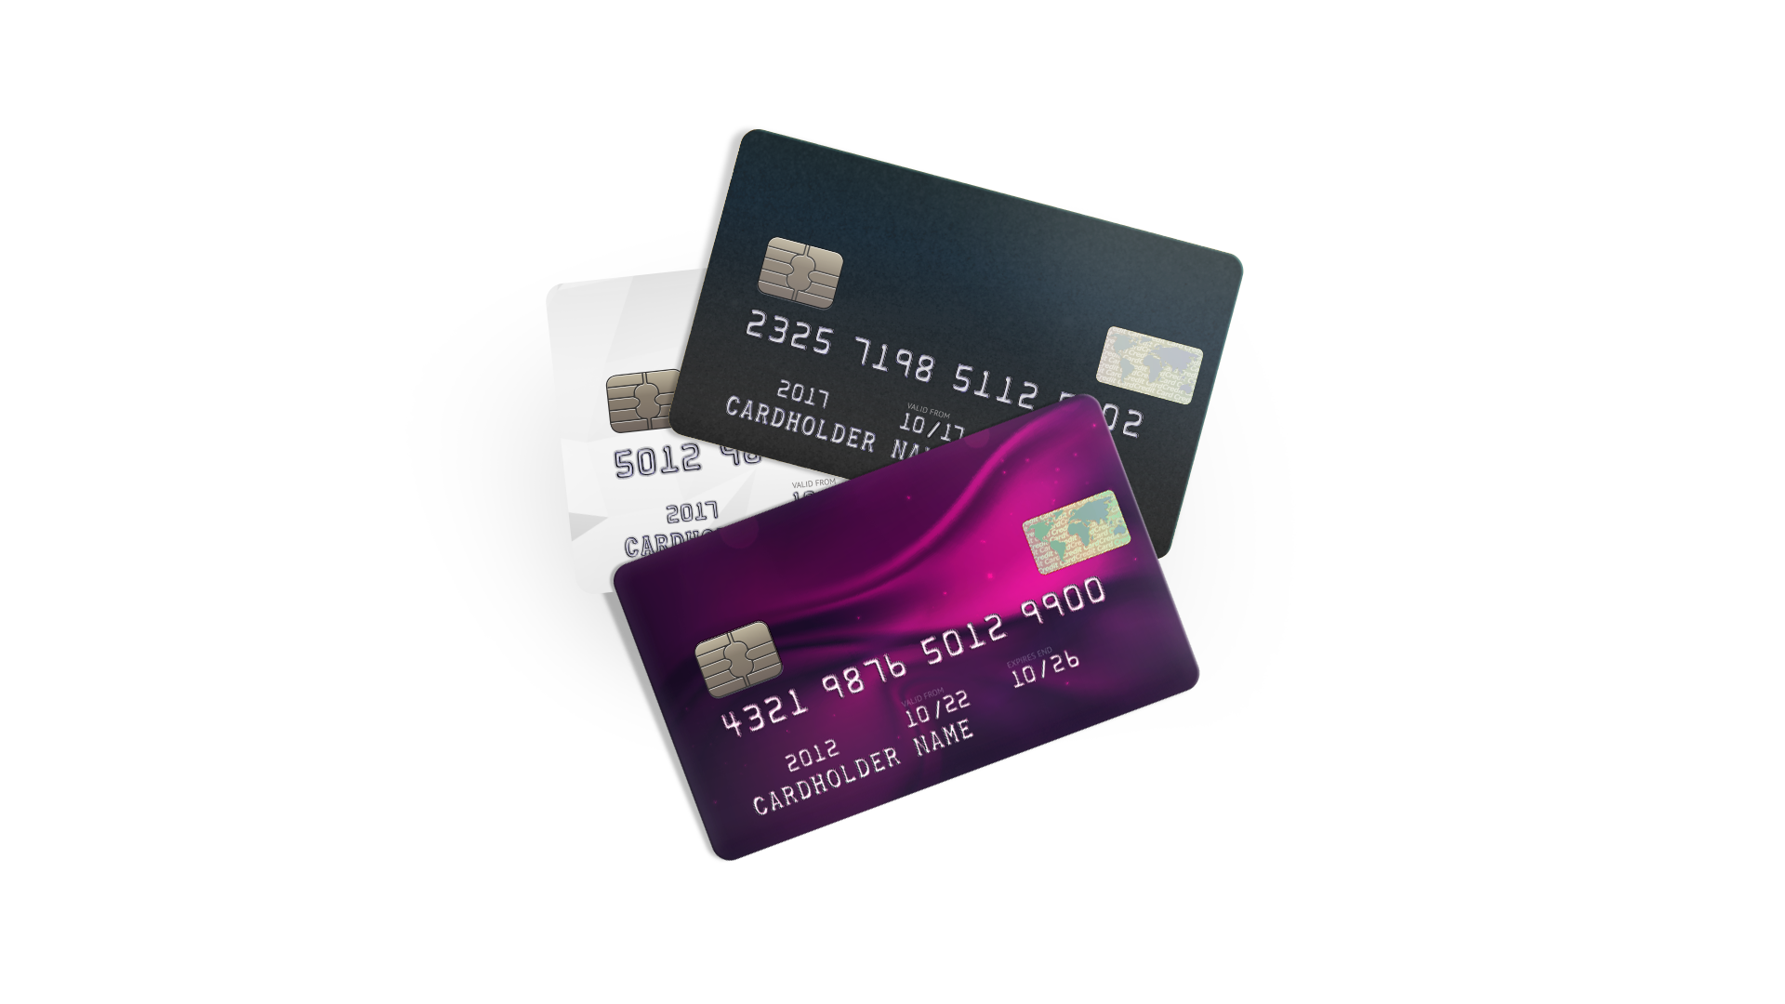
  Cash back
  Travel
  points
  Charity donations
Notes:
So one smart way to use a credit card is to pick one that lets you earn rewards. You charge your expenses, pay the balance off in full every month with zero interest, and collect a lil extra reward for yourself. Was travel one of your long-term adventures? Some credit cards help you earn points toward travel. Or maybe you want cash back—they’ve got a card for that. They even have cards that let you earn donations to your favorite charities.
And you might be thinking “well these credit cards sound great,” but the trouble is that it’s really easy to swipe or tap that card, each time feeling like you’re not spending real money. Or you get too confident about how much money you’ll have in the future, and you think you’ll be able to pay it all back. So you keep swiping and tapping, all while your debt is growing.

Slide 13

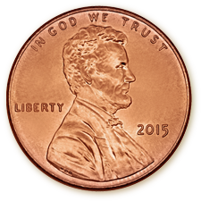
$0.01
$0.02
$0.04
$0.16
$5.12
  $1,000,000
Which would you
rather have?
  Sum of a
  penny doubled every day for
  30 days
DAY 1
DAY 2
DAY 3
DAY 5
DAY 10
$163.84
$5,242.88
$5,368,709.12
DAY 15
DAY 20
DAY 30
For illustrative purposes only
Notes:
Just as we talked about last week, compound interest is a powerful thing. It can be your friend and your foe. When it comes to savings (and investing) compounding is your friend, it works FOR you.
Let me ask you a question to demonstrate: Would you rather have $1M or the sum of a penny doubled every day for 30 days? Pop your answer into the chat....$1M or penny doubled?
[Facilitator note: give time to answer in chat]
For those of you who went with the penny, you’d be over $5M richer at the end of those 30 days! Crazy, right?! A penny that doubles in value every day is an imaginary illustration, but I hope you are getting the idea of how compounding interest works.

Slide 14
$0.01
$0.02
$0.04
$0.16
$5.12
  $1,000,000
Which would you
rather have?
  Sum of a
  penny doubled every day for
  30 days
DAY 1
DAY 2
DAY 3
DAY 5
DAY 10
$163.84
$5,242.88
$5,368,709.12
DAY 15
DAY 20
DAY 30
For illustrative purposes only
This imaginary example assumes a 100% rate of return on $0.01 for 29 days.
Notes:
This is an oversimplified example of how compound interest works in theory. Now there are no investments that can double your money every day, but the point is that money can make money. Even just putting a little away can lead to growth over time. And while it can absolutely work to your advantage when you are saving or investing...it can work against you when you borrow.
Just as your money grows in the penny scenario, your debt can grow at an exponential rate too. Let’s look at another example:

Slide 15
$650
$650
Initial balance
One-time purchase
$60
Total interest
$65
Monthly
payments
JAN
FEB
MAR
APR
MAY
JUN
JUL
AUG
SEP
OCT
NOV
DEC
After 11 months
Balance
Monthly payments
Interest accrued
For illustrative purposes only.
Source: Financial Mentor
Notes:
Let’s say you only pay off the “amount due” on your credit card bill, which is NOT the same as paying off the full balance.
Just like they’re happy to lend you the money in the first place, the credit card company is also happy to let you make a smaller payment each month. But every month you don’t pay off that balance in full, the interest starts piling up.
So let’s say you use your credit card with a 18% interest rate to grab a new phone. You end up with a $650 credit card bill.
And you only pay the minimum payment each month of $65 dollars.

Slide 16
$650
$650
Initial balance
One-time purchase
$60
$65
Total interest
Monthly
payments
JAN
FEB
MAR
APR
MAY
JUN
JUL
AUG
SEP
OCT
NOV
DEC
After 11 months
Balance
Monthly payments
Interest accrued
For illustrative purposes only.
Source: Financial Mentor
Notes:
You would pay it off 11 months later, and you’d pay an extra $60 in interest. How many hours of work would it take to pay off the interest alone?

Slide 17
$1,100
Additional purchases
$650
$650
Initial
balance
One-time purchase
$154
$65
Total interest
Monthly
payments
JAN
FEB
MAR
APR
MAY
JUN
JUL
AUG
SEP
OCT
NOV
DEC
After 12 months
Balance
Monthly payments
Interest accrued
For illustrative purposes only.
Source: Financial Mentor
Notes:
But what if you end up adding more expenses to the card each month…

Slide 18
$1,100
Additional purchases
$650
$650
Initial
balance
One-time purchase
$154
$65
Total interest
Monthly
payments
JAN
FEB
MAR
APR
MAY
JUN
JUL
AUG
SEP
OCT
NOV
DEC
After 12 months
Balance
Monthly payments
Interest accrued
For illustrative purposes only.
Source: Financial Mentor
Notes:
…even if you only add $100 each month, but keep paying the minimum, at the end of those first 12 months, you’d still owe $1,234! And if you kept doing the same thing, you would never pay off the balance and in about 42 years would owe ~$5.3 million!
It’s really easy to get behind on credit card payments and have the debt pile up if you aren’t being smart with when and how you use credit.

Slide 19



  Building credit builds trust
Credit
score
JAN
FEB
MAR
APR
MAY
JUN
JUL
AUG
SEPT
OCT
NOV
DEC
Late fee!
Late fee!
Notes:
Even with all that, credit cards have their advantages. Using credit cards can be a good way to “build credit” and sometimes teens may become authorized users on their guardians’ credit card just for this purpose. When the adult you share an account with has good credit and adds you as a user, that will be reflected in your credit score. But know that the opposite is true as well.
Ultimately when you use a credit card and pay back what you owe on time every month, it shows banks that they can trust you. And you need them to trust you if you’re ever going to want them to give you a lot of money one day to pay for a car or college or a house.
You’ll even need a history of good credit when you want to move out on your own and rent an apartment. Good credit tells the landlord that you’re responsible and can handle the rent.
Good credit can also save you money in the long run because good credit can get you lower interest rates in credit cards and loans. So down the road, when you go to get a new credit card or buy a home, or when you entrepreneurs want to take out a small business loan, you’ll get a lower interest rate.

Slide 20

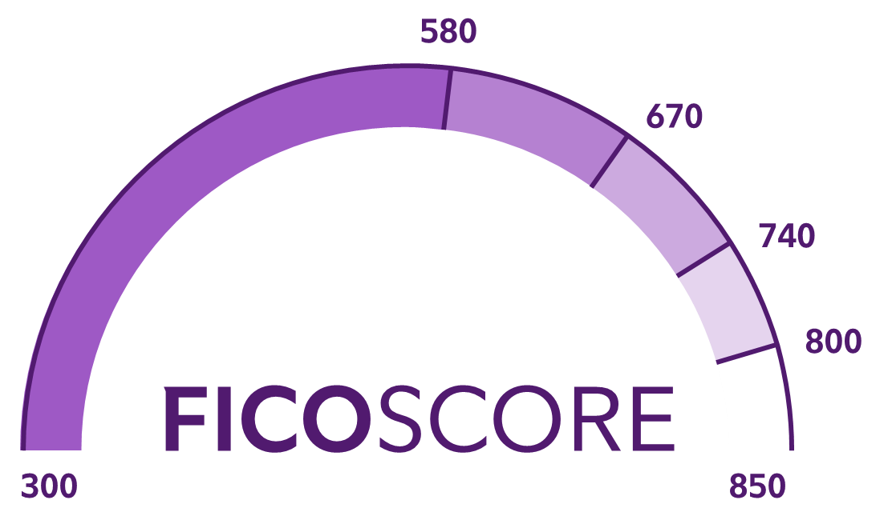

790
655
Credit score
Credit score
For illustrative purposes only
Notes:
Story time! Let’s compare two friends. Soraya has a credit score of 790 and Jason has a credit score of 655. Which of the two has the better credit score, Soraya or Jason? [Give a chance to answer]
Yep. Soraya has the better credit score. Your credit score is like grades at school – the higher the better. And while the difference between Jason and Soraya’s scores may not seem that big on the scale from 300-850, the difference becomes clear when we look at the impact their credit scores could have in dollars.

Slide 21

3.86%
10.24%
Annual percentage rate
Annual percentage rate
$459
$534
Monthly payment
Monthly payment
$2,527
$7,049
Interest
(over 5 years)
Interest
(over 5 years)
+$4,522
For illustrative purposes only.
Source: www.myfico.com
Notes:
Let’s imagine Soraya and Jason go to buy a new car...the same new car...because besties. If they plan to finance that car (a fancy way of saying - take out a loan), it will impact their interest rates as well as monthly payment, and ultimately how much they spend overall.
Let’s start with interest rate – this is the percentage the lender charges them to borrow the money to pay for the car. [Click]
We already see the gap between the two widening, Soraya qualifies for a loan at 3.86% and Jason's loan will be at 10.24% annually. Now that adds up! [Click]
Soraya’s monthly payment will be $459, while Jason’s is $534. Imagine what you could do with an extra $75 bucks a month (cough, pay yourself, cough cough, put it into savings)! And when you draw that out to the interest paid over the course of the (let’s say) 5 year loan [Click]....
Soraya’s going to pay $2,527 and Jason will pay over $7,000 in interest. He’ll be spending over $4,500 more than Soraya to buy the same car. Just because of his credit score.

Slide 22

4.2%
5.24%
Annual percentage rate
Annual percentage rate
$1,467
$1,655
Monthly payment
Monthly payment
???
???
Interest
(over 30 years)
Interest
(over 30 years)
~$7K
~$32K
~$68K
~$82K
For illustrative purposes only.
Source: www.myfico.com
Notes:
You think that’s rough; you should see what happens when they both go to buy a condo that happens to be the same exact price.
They both apply for a 30-year loan (which is a pretty typical period of time for a home loan) and this time their annual interest rate doesn’t seem all that different. [Click] Soraya’s is better at 4.2% and Jason’s is 5.24%. Even their monthly payment isn’t wildly different. [Click] Soraya’s is $1467 and Jason’s is $1655.
Now let me ask you, what do you think the difference in interest they’ll be paying will be? Let’s annotate your response this time. Go up to the bar at the top and select the option that says ”annotate.” Click there then click the stamp button, pick a stamp (any stamp) and mark on the screen what you think the difference in interest will be between Jason and Soraya over the 30 year period?. A. $7,853, B. $32,426, C. $67,766, D. $81,888.
[Give them time to annotate]
For those of you who guessed C, you would be correct [click] Over the course of 30 years those seemingly small differences become quite large – to the tune of $67,766.
Pretty wild, right? What do you think about this? Did the difference good credit can make surprise you?
Just another plug for building credit so you can get those lower interest rates. And it should go without saying, making sure you stay on top of your payments so you have a good credit score.

Slide 23
Notes:
[facilitator note: Take a few minutes to open it up to discussion. See some ideas for discussion questions below.]
Pretty wild, right? What do you think about this? Did the difference good credit can make surprise you?
What other ways could you imagine credit score impacting Jason and Soraya?
What can we learn from this example? What might you do differently now that you know this?
The difference between these friends for a 1br was in the tens of thousands of dollars. Imagine if it was a bigger or more expensive house? The difference could be upwards of $100,000!
Just another plug for building credit so you can get those lower interest rates. And it should go without saying, making sure you stay on top of your payments so you have a good credit score.

Slide 24

  Reserve loans for things that
  bring you value in the future
Credit
score
  Payday loans give you quick
  cash with very high fees
Notes:
Jason and Soraya may have needed those loans. There are just some things that – unless you’ve saved thousands of dollars – you’re going to need a loan for.
Take, for example, going to college or trade school. It can be really hard to save up enough money to pay for tuition, and books, and even living expenses. That’s why there are special student loans with low interest rates to help you. And when you get a student loan, you’re making an investment in yourself and your future.
[CLICK]
But people get themselves into trouble with loans just like they do with credit cards, so you have to be careful to only take what you must, and to always read any loan agreement before you sign. Because once you take the money, it will be your responsibility to pay it all back.
And something to avoid completely is a payday loan. That’s when you go borrow money from a company, and you promise to use your next paycheck to pay off the loan, but for a really high fee. Usually between $15 and $20 for every $100 you borrow. And then if you miss the payment deadline, they charge you interest on the new amount! Whooooh. Not worth it!
But loans CAN be ok if you spend smart, so when you think you might need a loan for something that’s worth it, it’s a great idea to have someone you trust helping you through the loan process.

Slide 25

Guess the price!
Credit Card
20.00%/APR
Over 2 months
Credit Card
22.00%/APR
Over 1 year
Payday loan
$800.00
$860.00
$905.00
$905.00
$940.00
$933.00
$995.00
For illustrative purposes only
Notes:
Oooh, I can tell we’re smarter spenders already! Now that we’ve got a better handle on smart ways to use cash, credit, and loans, let’s go back to our Guess the Price game.
Let’s say you wanted to buy a new tablet for your side hustle, and you found one you loved for $800. After sales tax, that total you would pay comes out to ~$850. That’s right, we didn’t even talk about sales tax that we pay on things we buy, but I bet you’ve noticed that one before.
Now, you know the rules, I’m going to have you guess how much this tablet would end up costing according to a few common scenarios. [CLICK ANIMATION}
Let's say you paid with a credit card with a 20% interest rate, but your birthday was coming up and you knew you’d get some cash so you paid it off in 2 months – gimme your best guess, put A, B, or C in the chat...how much would it cost you? A. $860 B. $905 C. $933 [Facilitator note: give them time to guess] [CLICK ANIMATION]
The correct answer is A: $860! Not so bad, you were willing to pay a slightly higher price because you knew that’s how you wanted to spend your birthday money.
Okay, this time you paid with a credit card with a slightly higher interest rate – 22%, but it took you a year to pay off. How much would that cost you then? Put your best guess in the chat. A. $905 B. $940 C. $995 [Facilitator note: give some time to guess] [CLICK ANIMATION]
If you guessed B, $940, you’d be correct. This may not sound too alarming, but if you thought it was a good idea to charge the tablet and take a year to pay it off, then you probably charged other stuff to that card, too. And remember that’s where the interest can really start to add up. [CLICK ANIMATION}
Finally, let’s say you took out a payday loan [give it a nice long pause here] [CLICK ANIMATION]
Trick question...you wouldn’t...this is NOT a smart way to spend with loans! We want to avoid payday loans because with all the added fees and interest, it’s just not worth it.

Slide 26





You’ve finished this
session and earned a
roadmap builder pin!
3 / 5
completed!
Let’s collect them all!
?
?
Notes:
You’ve earned another pin!
First of all, we are more than halfway through and y’all are rocking it! Look how far you’ve come!
And now you have a better sense of what it looks like to spend smart. You don’t just have the lay of the land anymore, you’ve built the roadmap for your future.

Slide 27
05
01
Build your roadmap
Strategy for spending smart
Adventure awaits
Financial know-how in action
Let the adventure begin
Short-term / long-term goals
04
Lay of
the land
Savvy saving habits
Boost
your plan
Jump into investing
Notes:
And next week, we’ll set our sights on the exciting part of growing your money and dive into investing.
Here’s where you’ll really see the power of compounding and how you can use it to help you meet those long-long term goals.

Slide 28

Explore
more!
Career salaries
Research salaries in careers that interest you
SEARCH
Notes:
For those of you who can’t wait until next week, here’s a way to explore more:
We’ve talked a lot about spending and saving, but you have to earn money before you spend and save it.
This week, you can explore more by doing a deep dive. Maybe you know what you’d like to be when you grow up or you’re curious about the salary different jobs make. Do an online search of those jobs and their salaries to learn more!
I’ll be excited to hear what you learn next time.

Slide 29

Investing involves risk, including risk of loss.
The third parties mentioned herein and Fidelity Investments are independent entities and are not legally affiliated.
The trademarks and service marks appearing herein are the property of their respective owners.
Fidelity Brokerage Services LLC, Member NYSE, SIPC, 900 Salem Street, Smithfield, RI 02917
© 2022 FMR LLC. All rights reserved.
1024011.4.0

