Slide 1
Facilitator Guide
MODULE 01: LET THE ADVENTURE BEGIN
  Thank you for leading this module: “Your Money Adventure.” Over the course of five 1-hour modules, you will be helping teens become savvy spenders, savers, and investors. We’ve designed this module to include a mix of lecture, activities, examples, and discussion so it’s engaging for the teen audience. Here are some tips to help you prepare and lead the modules:
  You’ll see speaker notes on each slide that read like a script, but we encourage you to ad lib, put it in your own voice, and (*very importantly*) don’t read this word-for-word (that’s a way to lose the teens quick!).
  Sprinkled throughout the speaker notes are bracketed Facilitator Notes that we’ve left for you. These notes offer extra context for the slide, but you should not read those aloud while facilitating.
  We highly recommend you practice each module aloud before delivering it, especially because there are places where you need to add a personal story/example. This practice will help you connect to the message and deliver it authentically.
  On the next page, you’ll find timestamps for how long each section of the module should take. Keep track as you’re presenting to see if you are too far ahead or behind. If you are, make an adjustment.
  We’ve also found that facilitators who use dual monitors have better engagements during virtual presentations. Put the deck in play mode on your second screen and share that screen. Then, have your speaker notes on your main screen where your camara is. Move the speaker notes to as close to the top of the screen as possible so you can maintain eye contact while presenting.
  Throughout the modules, you’ll be sharing your screen, sending the teens to breakout rooms, using the poll and white board features, and managing the chat. Make sure you are comfortable with all of these interaction tools.
  We know teens can be intimidating but think about how THEY are feeling – finance is intimidating...money is intimidating! Be empathetic to that. Take your time with these concepts and show them this stuff doesn’t have to be as inaccessible as they may think.
  You’re not a regular facilitator, you’re a cool facilitator...WE know that, but teens don’t. They don’t think you’re cool. And that’s ok! Lean into it. Don’t be afraid to geek out a bit. Finance is your jam!
  Start strong. You set the tone for the entire module on day one – really in the first 30 seconds on day one. Especially when you have to deliver virtually, YOU will need to bring the energy to their screens through your voice, your gestures, and your engagement with the material and the students.
  Every audience, whether they’re adults or teens, will pay more attention to what you say if you to show passion and enthusiasm for the topic you’re presenting. Tap into the awesome fact that you get to help young people on their road to financial success! Now THAT’S something to get excited about! Let your enthusiasm and excitement be infectious! It will carry you a long way.
  Hide or delete the facilitator guide before facilitating the module.

Slide 2
Timing Breakdown
MODULE 01: LET THE ADVENTURE BEGIN
Section | Duration |  | Section | Duration
Introduction: Welcome through My idea of adventure is different from yours | 3m |  | Group discussion | 6m
What adventures do you dream about? | 3m |  | Group activity | 6m
Let’s talk about those adventures | 3m |  | Program overview, Let the adventure begin | 1m
Introduce curriculum | 1m |  | Dream Big and Small: Adventure awaits | 1m
You are Here: Where you’re starting from | 1m |  | Individual goal-setting activity | 12m
Knowledge Check and Review | 7m |  | Achievement unlocked and Share | 4m
Let Us Be Your Guide: Celebrity missteps, Doin’ it for the ‘gram | 4m |  | Close: Close and Explore more! | 2m
Adventure Costs Money: Small group activity | 6m

Slide 3

Welcome!
I’m so excited to
have you all today!
01 Camera on if you can
02 Mic on mute until
you're ready to share
03 Grab a pen and paper
or open a new document
Notes:
[Facilitator note: Log on a few minutes before the start of the module. As students are joining the Zoom, you’ll want to give them instructions of how to prepare. This moment of interaction will both save time later and create an engaging/inviting atmosphere]
Hello! If you can, we’d love to have you on camera for this workshop and your mic on mute until it’s time to share! [Facilitator note: It’s best to make “camera on” optional and not try to pressure students to come on camera]
While you’re getting settled in, make sure to have a pen and paper handy, or open a new document on your device. We’ll be doing a few exercises today where you’ll need to write out your answers. You will return to these answers throughout our workshop series, so make sure you keep track of where you put your notes or document!

Slide 4


Education Content Created By
Your Money Adventure
01 Let the adventure begin
Speaker Name | Speaker Title
Date
Notes:
[Facilitator note: Once all students have joined and turned on their cameras, you give a more formal introduction]
And now that it looks like we have everyone, let me welcome you to “Your Money Adventure”.
I’m so excited to have you all here today!
Learning more about personal finance is a lot like starting a great adventure! I hope you’re feeling eager to learn more and get started, but I know you might also be feeling like we’re about to cover a topic that is totally unfamiliar to you.
While money talk can feel super intimidating, it really isn’t as complicated as it’s made out to be. This program is going to be easy, even fun! And the good news is, by the end of our time together, you’ll have new tools and skills to help you use your money for the adventures that matter most to you.

Slide 5


Yup…
that’s me
Notes:
Since we’ll all be learning together, let’s take a moment to get to know each other.
[Facilitator note: Briefly share your name, role, and how you got interested in personal finance. Even better if your story starts when you were a teenager]
I can see all your names in the Zoom, but let’s take few minutes to get to know each other by typing into the chat your answer to this question:

Slide 6


If money grew on trees,
what’s one thing
you’d spend it on?
Notes:
If money ACTUALLY grew on trees, what’s one thing you’d spend it on today?
[Facilitator note: Make sure to add your response to the chat too. There’s going to be a few seconds of lag between you asking the question and when responses to start to appear in the chat. Once responses do appear, read out loud what you’re seeing. Feel free to add your own color here such as “ooh, I’d like that too!” or “I’ve never even heard of that!”]
A money tree could help us get everything in the chat. But…

Slide 7






Notes:
...and you’ve probably heard this one before... “money can’t buy you happiness.”
And for the most part that’s true. Having all the money in the world won’t get you love, or true friends, or the perfect family. No, money can’t buy you those things.

Slide 8






Notes:
...what money CAN do for you is open up a world of possibilities, of choice, of adventure.

Slide 9


Adventures
I dreamed about
Notes:
When I was 15, my idea of adventure was…
[Facilitator note: insert something you wanted at 15 and explain why you wanted it. For example, “When I was 15, I really wanted a car because I worked at a local fast-food restaurant after school and on the weekends when my parents couldn’t drive me, and I had to walk to get to work.”]

Slide 10

Today, this is
my adventure
Notes:
Today, my idea of adventure looks like…
[Facilitator note: Finish the sentence about what “adventure” looks like to you today, such as “paying off my student loans” or “saving for my own kid’s college.”]
I’m not a betting person but can say with confidence that the adventures you want to take are probably different from mine. And they’re likely different from each other’s, too!
Maybe you dream of studying abroad one day, you’ve got your heart set on going to that concert, or adventure awaits in that video game you want to buy.

Slide 11

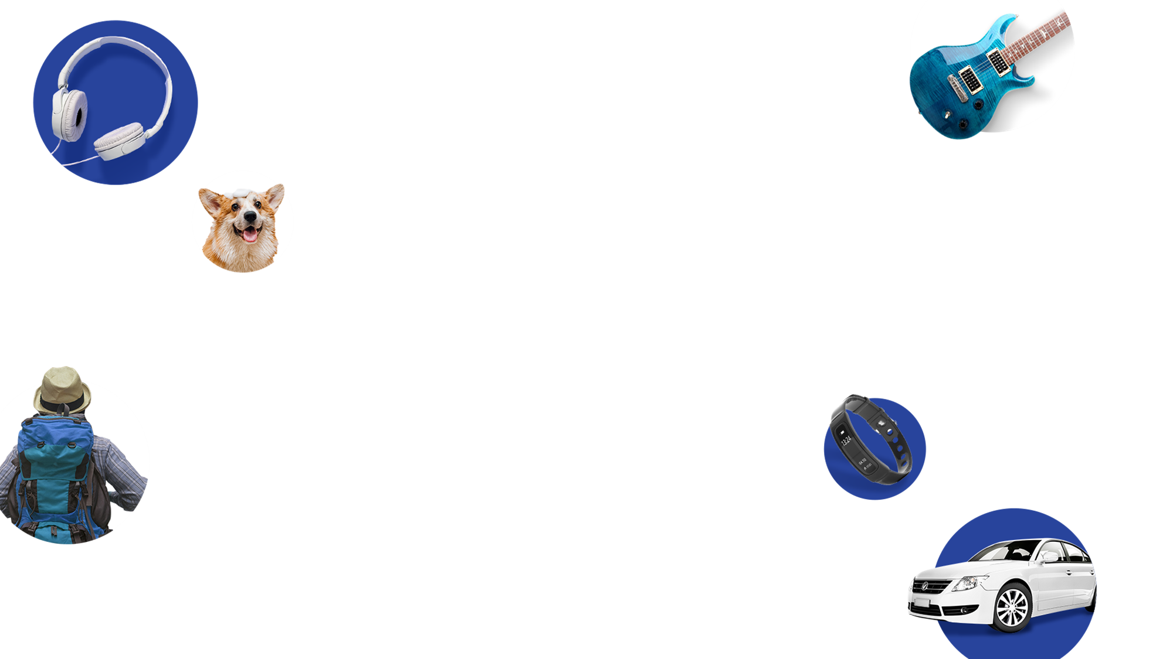
What adventures
do you dream about?
Write down a list of big ($$$) and small ($) ideas and be ready to talk about them with the group.
Notes:
Let’s spend some time dreaming up YOUR next adventure.
Now some of you may say – Oh I KNOW what mine is! Others of you may be thinking – yeah, I’ve got about 50 in mind. And some of you may need some time to figure out what adventure looks like for you.
Let’s take the next three minutes to ourselves to brainstorm and dream up what your next adventures might be. Think of these adventures as a goal - something you’re aiming for or hope to accomplish, but you know costs money. It’s one thing to think about our goals, but researchers have found that actually writing your goals down can increase your chances of achieving them! Can’t hurt to try, right?
So go ahead, come up with a couple of ideas. Think big and small about things you’d love to spend money on. Think about things you want now, in a few years, or even way down the road when you’re old like me. Go ahead and write ‘em down, and be ready to share at the end of those 3 minutes.
[individual work – 3 mins]

Slide 12
Notes:
Ok, let’s come back together as a group. Sometimes hearing other people’s ideas help spark new ideas for ourselves. So, who wants to kick us off?
[Facilitator note: It can sometimes be hard to get teenagers to share, but the reason we gave them individual work first was so they felt less “put on the spot.” Be ready to sit in silence for up to 15 seconds before you jump in and ask someone to share. Hopefully, more people will join in after the first. If not, keep calling on people until you’ve spent about 3 minutes in this group discussion]
[Group Discussion: 3 mins]
This list is impressive and exciting! Whatever your next adventure might be, it sounds to me like money will probably play a role. I want to help you set off on that next adventure and give you the tools to start getting there.

Slide 13

  We will teach you how to save, spend, and invest
  You will have a great start
Notes:
Over the next 5 weeks, I’m going to teach you how to spend, save, and invest with your adventures in mind. There will be hands-on activities so you can make all this information connect to your own goals.
You’ll have choices along the way. Like “Do I want to save all of my money toward my first goal, split it up between multiple goals, or spend it now?” Or “Am I ready to put my money towards long-term goals or do I want to focus on short-term wins?”
By the end, you’ll have a great start that you can be confident about.

Slide 14

Knowledge
check
Please use the link below to view the questionnaire
Knowledge check
Notes:
But before we do that, let’s get an idea of where we’re starting from...

Slide 16

Popular Singer
Shady accountant
Bankrupt
Notes:
Just as with any adventure, there can be detours and setbacks along the way. There isn’t always a simple path from point A to point B, even when you DO have the money.
Take some of these celebrities as an example. We may look at them now as the pinnacle of financial success, but they learned some hard lessons along the way.
[CLICK]
Early on, a popular female singer spent her money like it wouldn’t run out. Unfortunately, she had a shady accountant managing her money and she basically ended up bankrupt for a time. She never said it, but it’s widely assumed that the music video for “B---- Better Have My Money” is about this detour.

Slide 17
Popular Singer
Shady accountant
Bankrupt
Popular Artist & Actor
Invested $35M
in Social Media Platform
Huge loss
Notes:
Another example. Way back before there was Instagram or TikTok, there was another social media platform that no longer exists. A popular male recording artist and actor invested $35M in the company in 2011. As with every investment, he took a big risk ... but didn’t come out on top with this one. Yikes.

Slide 18
Basketball Star
Neither saved nor invested money
Missed opportunity
Popular Singer
Shady accountant
Bankrupt
Popular Artist & Actor
Invested $35M
in Social Media Platform
Huge loss
Notes:
Or take former basketball star who went from making $200 in college to becoming a millionaire over night. He’s said he wanted to save a million that first year in the league, but he didn’t know a lot about money or have anyone he trusted. In the end, he saved nothing that first year and says it’s one of his biggest money regrets. He wishes he had learned how to spend his money early on ‘cause he’d be a lot richer today.

Slide 19
Instagram influencer
Lacked money
“know-how"
$10,000 debt
Notes:
And it isn’t just celebrities who can experience financial setbacks. There’s so much pressure to be a certain person on social media that ”doin’ it for the ’gram” can sometimes come at a high cost if you aren’t thoughtful about how you spend your money. Even influencers who project a perfect life on Instagram may have found themselves in financial trouble.
[CLICK]
One Miami influencer with a large following found herself $10,000 in debt. Even with brand partnerships, she didn’t have the right saving, spending, and investing tools in place to get those perfect insta-worthy images.
I like to think that if she had the right money know-how, she could have kept being an influencer and gotten paid to do it.

Slide 20
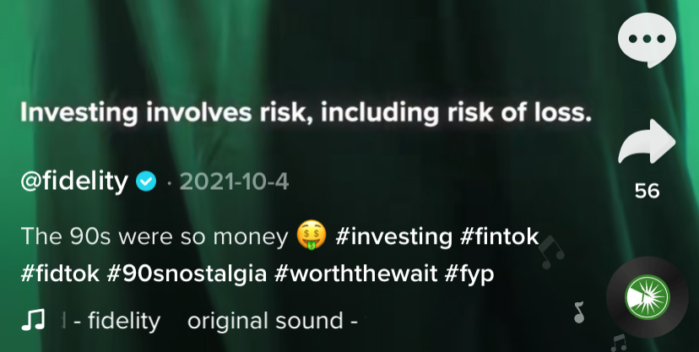

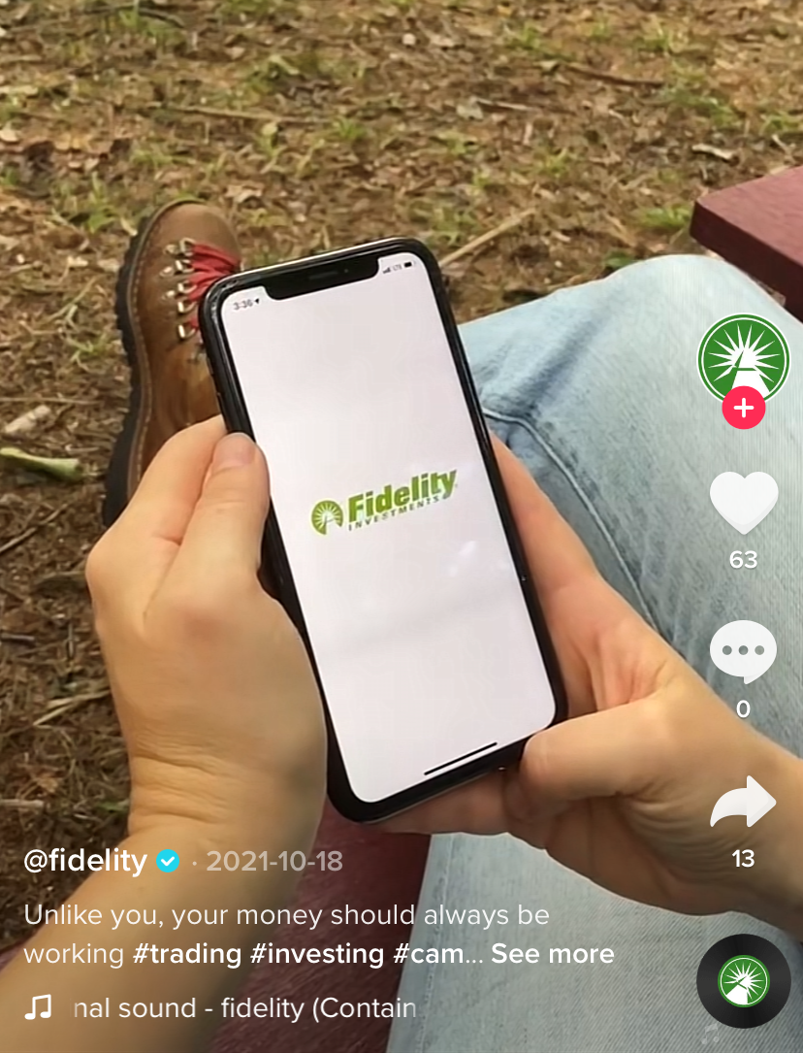
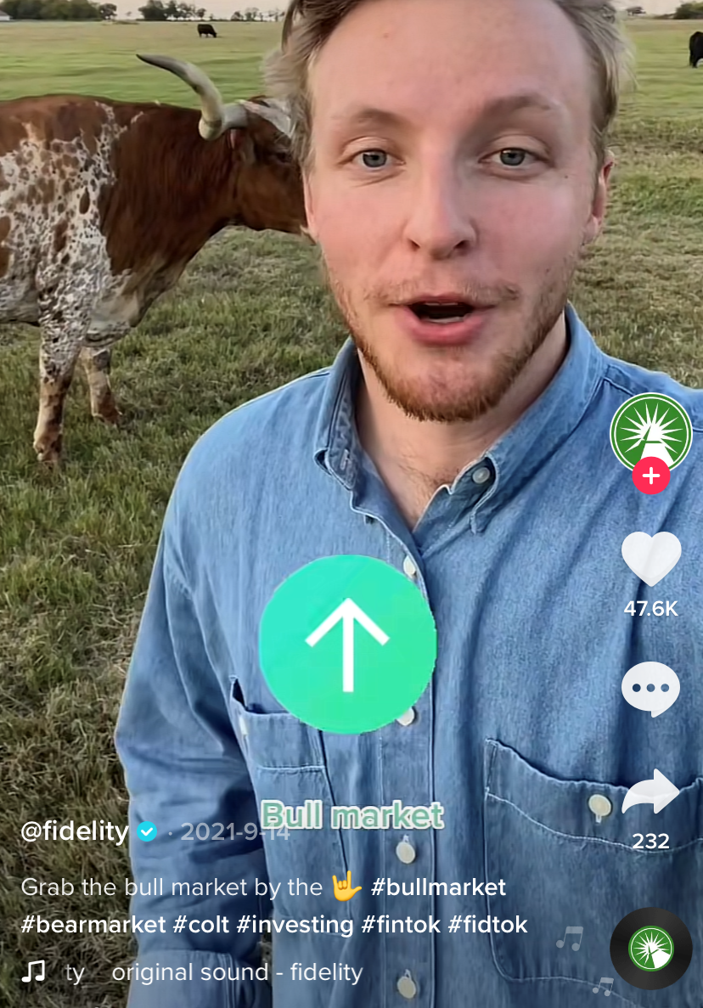

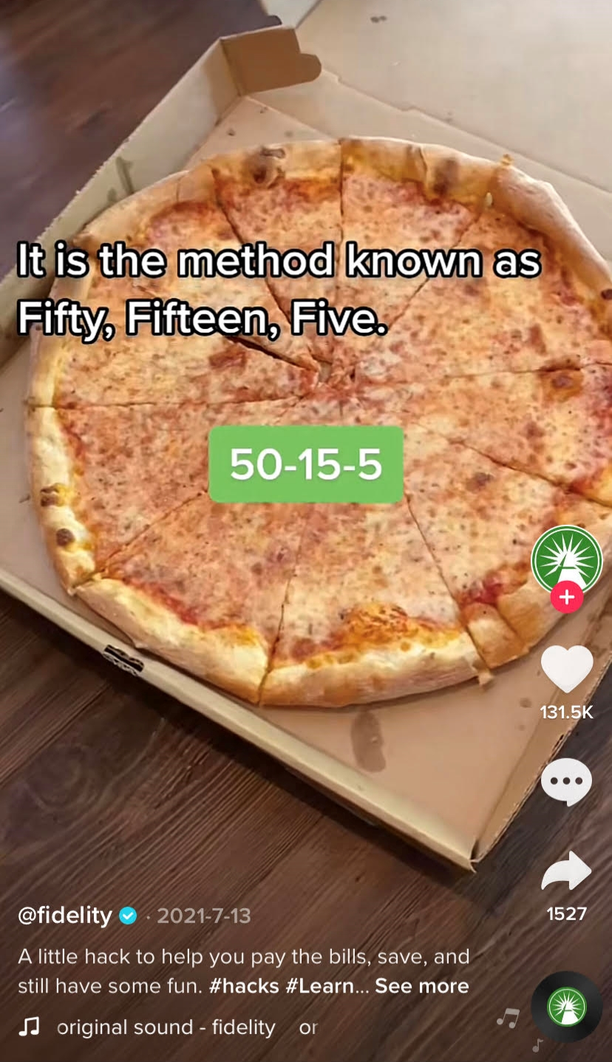
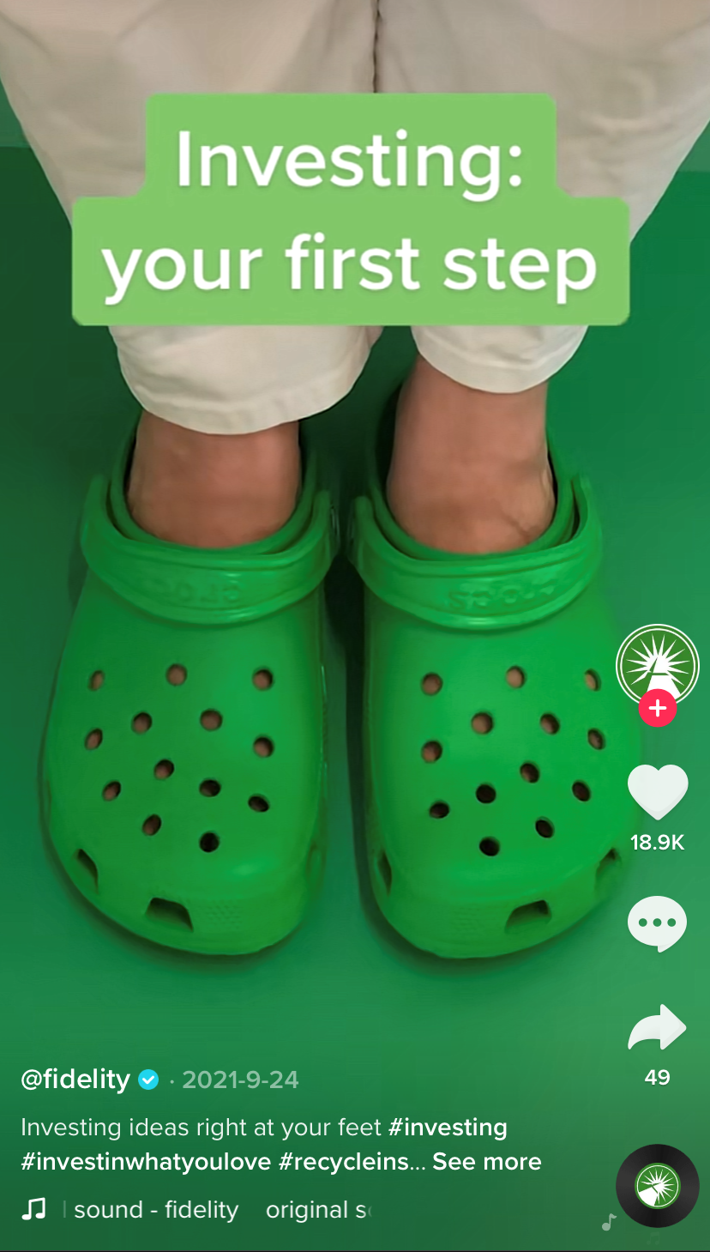
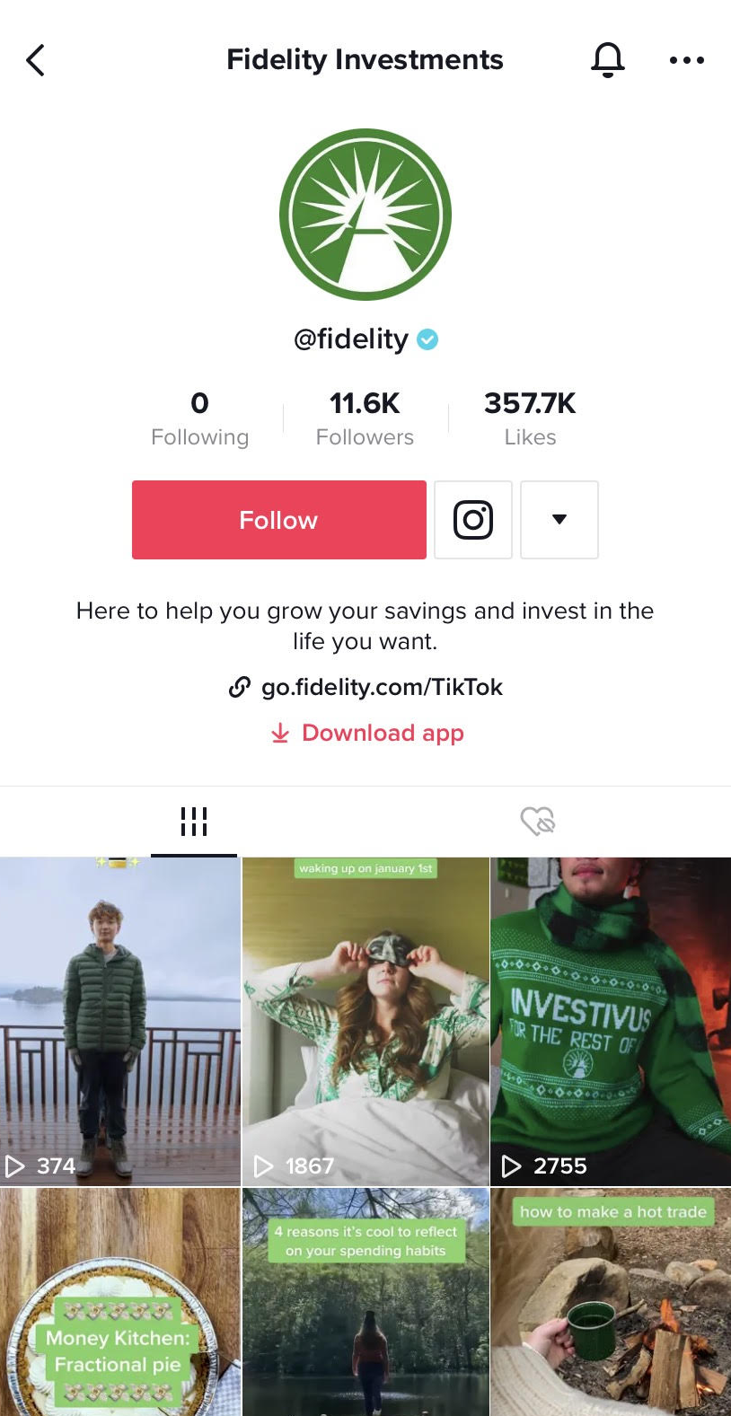

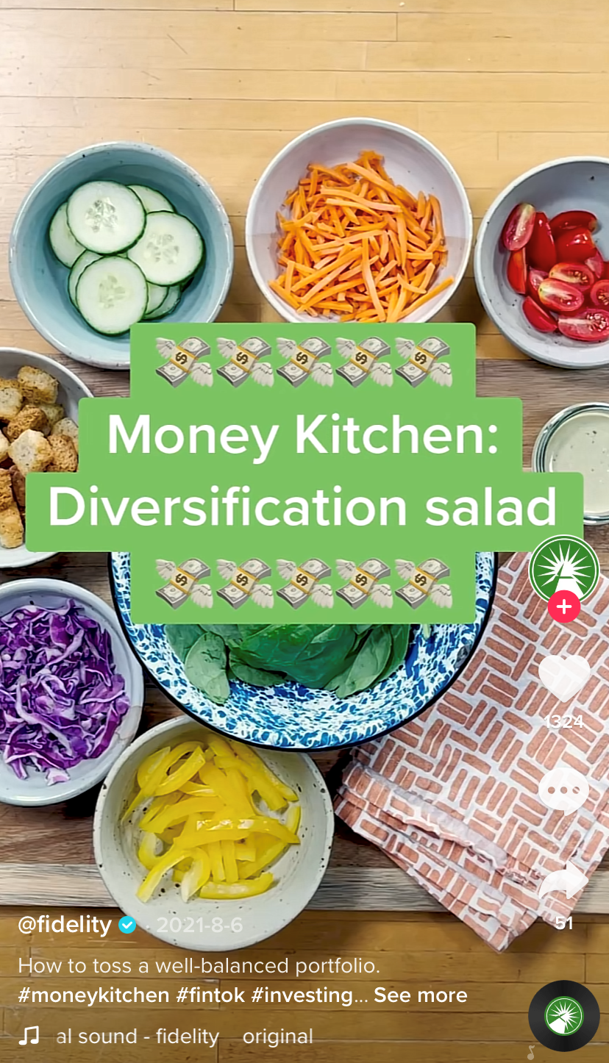
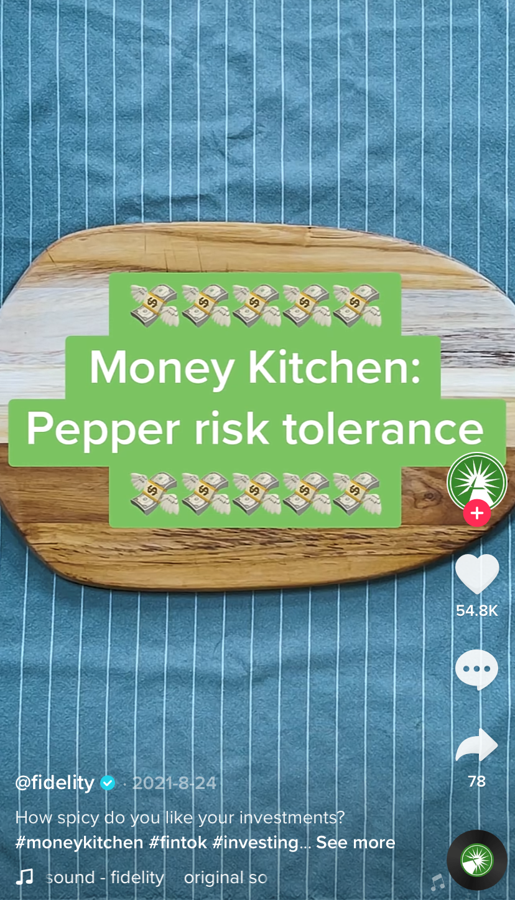
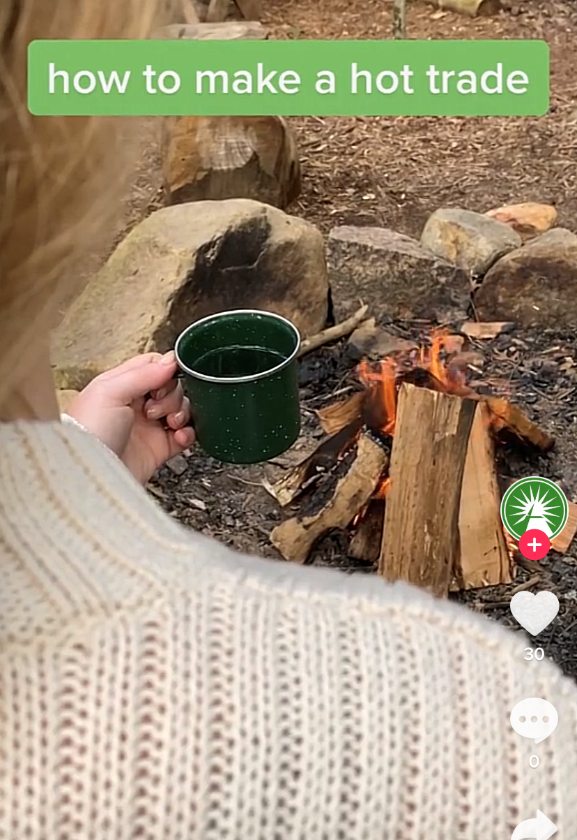
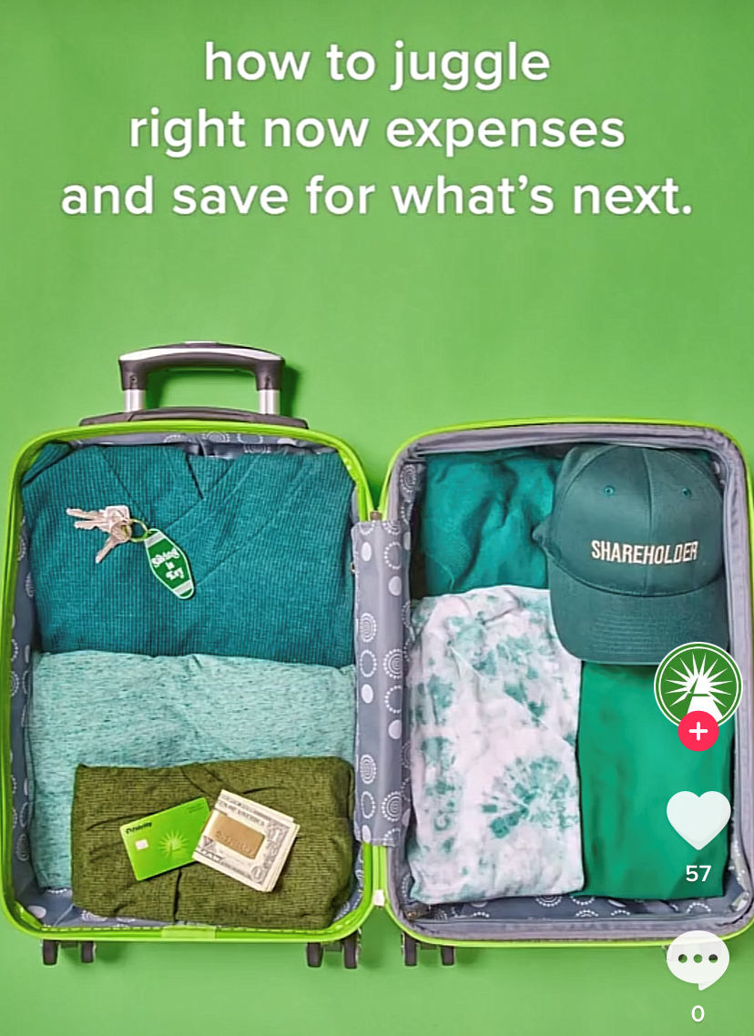
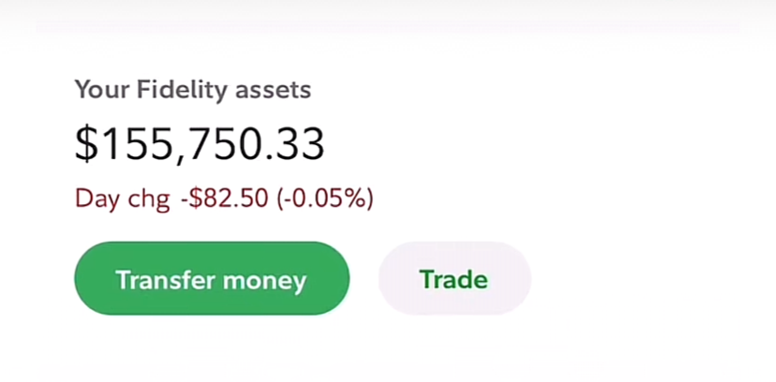
@fidelity
Images for illustrative purposes only
Notes:
Now social media can be pretty amazing too! Even Fidelity has its own Instagram and TikTok accounts!
With hashtags like #fintok with nearly 800 Million views and #MoneyTok with 10.5 billion views - nope, I didn’t stutter - 10.5 BILLION views on TikTok ... there’s a TON of financial information and advice out there! And everybody has access, which can be an incredible and democratizing thing!
But with SO much information out there it can be easy to get lost too. And as you embark on your adventure, we don’t want you to be misled (like the female singer) or not know any better (like that influencer from Miami).

Slide 21

We are here
to be your guide
Notes:
We are here to be your guide.
Yes, Fidelity is in the business of money to make money, but they are also a business with a mission. The CEO Abby Johnson said, “The reasons why we exist hasn’t changed since our founding…to strengthen and secure our clients’ financial well-being” and for young people, that means helping them with financial education.
They have spent over 75 years focused on helping clients build towards their goals. And now, using their education materials, we want to do that for adventure-seekers like you.
If some day down the line you happen to invest with them? Great!
If not, that’s ok too. Our goal here is to help you grow into a savvy saver, spender, and investor, so you can sort through all that’s out there. Then, you’ll be able to make the best decisions for you.
And right now, those goals are the adventures we talked about already. But before we help you think about your money in terms of those goals, let’s talk about the money it takes to cover the things you already have now.

Slide 22

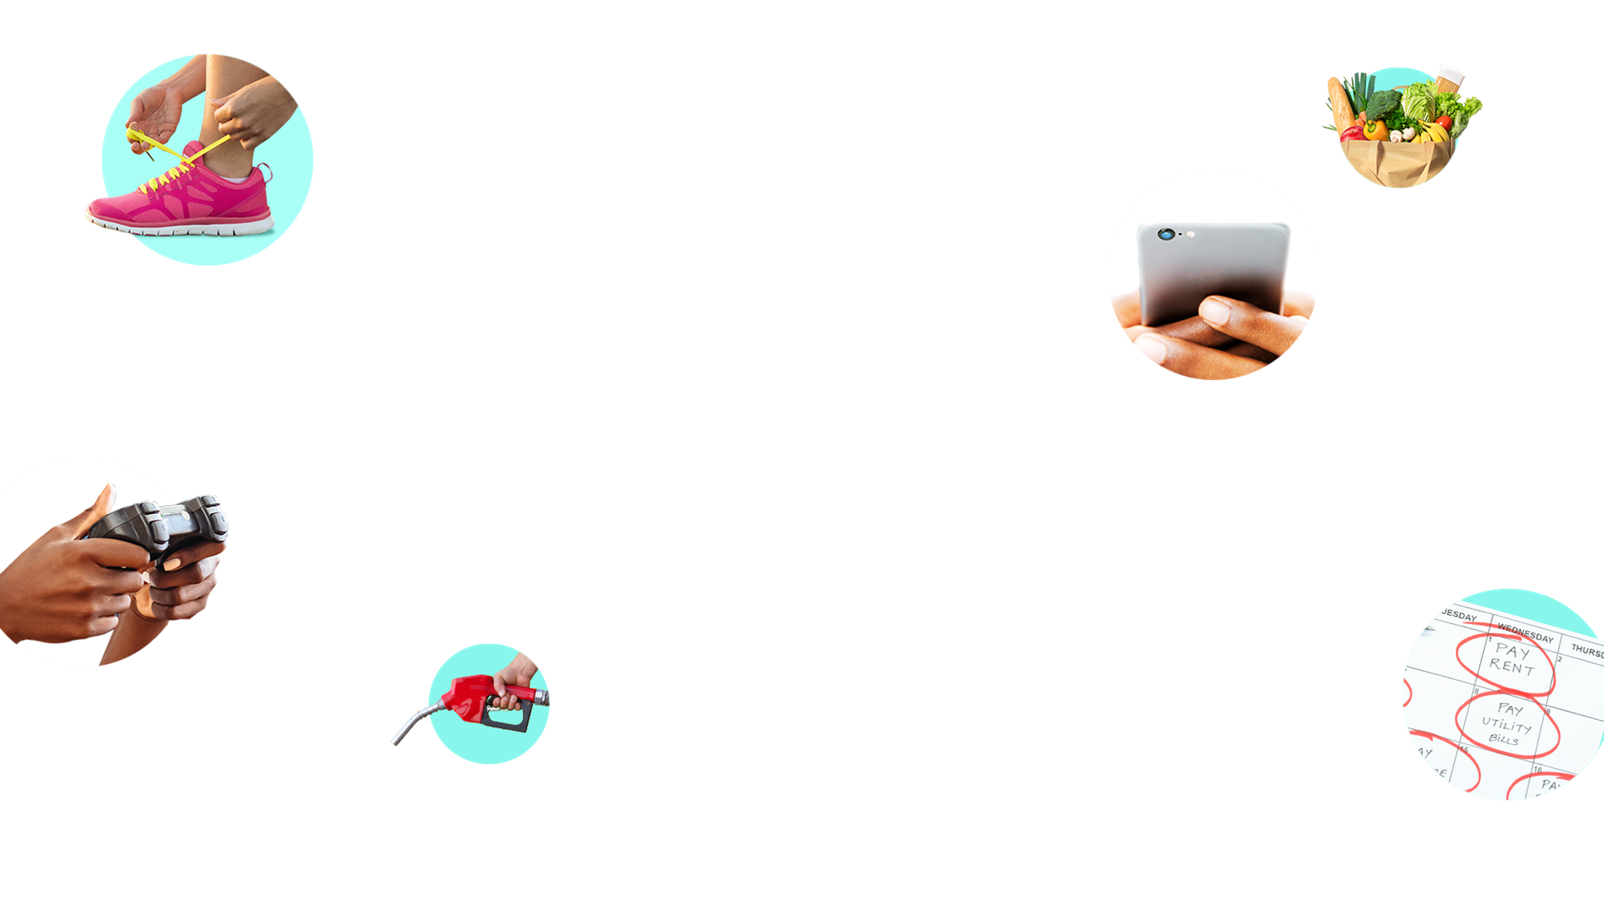
List all of the
things in your life
that cost money
Pick someone to take notes
Notes:
To do that, I’m going to put you into breakout rooms.
In just a minute, I’m going to send you off with a few other people. I want you to come up with a list of all the things in your life that cost money. We’re talking streaming movie services, your cell phone bill, your car insurance, your hobbies, your lunch! These could be expenses that you pay for yourself, or it could be expenses that the adults in your life are taking care of for you…for now.
Designate one person in your group to write down everything you list, either on their paper or in a document. After five minutes, we’ll come back together and share your lists with the group.
Before you get sent off into breakouts, any questions?
If a question pops up, click the “raise your hand” button and I’ll pop into your breakout room.
Ok, I’ll see you in a few minutes!
Alright, welcome back! Did any of you have a hard time coming up with stuff for your list?
[Facilitator note: If they nod their heads yes, then say “Totally understandable! It’s sometimes hard as a teenager to know all the expenses that we depend on because we aren’t always the one in charge of paying for them!”
If they nod their heads no or shrug off the question, “There’s SO much, right? When we start to think about the things we need and do (from the simple everyday things to the big-ticket things), it really starts to add up!”

Slide 23
Notes:
So, let’s hear what you came up with and make a master list. I’m going to stop sharing these slides and pull up the Whiteboard so I can make the list for us.
Who wants to go first?
[Invite groups to share their lists – give this 5 minutes max]
This is a great start! But now we need to figure out how much this stuff costs!
I want each one of you to pick something from this list that you have or use in your life AND that you DON’T already know what it costs.
Do a quick search on your computer or phone and find the price. If it’s something with a price that changes based on who is selling it or the specifics of the thing, look at a few websites and compare.
When you’ve got the cost, type in the chat 1) what you looked up, 2) what the price is, and 3) where you got that price from. Then, I’ll add it to our whiteboard.
[Facilitator note: The idea here is that everyone is getting involved and starting to find out how much things cost; discussion is happening as you pop the dollar amounts into the whiteboard –
e.g. “A tank of gas is $80! That’s a big expense...and will change depending on where you live or how many gallons your tank takes, and here’s a price that changes all the time...” This exercise should take 5 mins max]
It’s good to start to get a sense of how much all this stuff costs...

Slide 24
03
05
01
Build your roadmap
Spending and saving in action
Adventure awaits!
Share the knowledge!
Let the adventure begin!
Short-term / long-term goals
04
02
Boost
your plan
Jump into investing
Lay of
the land
Intro into saving
and spending
Notes:
As you can see, we’ve got everyday expenses and big adventures ahead. That’s where spending, saving, and investing come in.
Those three topics are going to be the focus of our adventures together over the next couple of weeks (all while you build a plan to work towards the adventures you’re seeking). And you’re already on your way!
This week, you’re identifying short- and long-term goals (more on that in a minute).
Your next steps will be to develop a spending and saving plan.
And when we talk about investing, you’ll develop (you guessed it!) an investment plan.
Together, we’ll explore the tools you can use with your money. And you’ll see how the choices you make lead to different outcomes.
And all of this will culminate in the last week, where you’ll become the teachers, as we play a game to help better understand the topics we cover together.

Slide 25

Notes:
So, let’s start to really map out our goals. We did some pretty great brainstorming at the start of today. And maybe our group discussion even sparked a few new ideas for you.
Now let’s take the time to zone in on two of those goals.
The first will be a smaller, short-term goal. AKA something you could realistically save for and get in the next few months. This would be a lower ticket item or experience for you. Maybe the goal is a movie date you’d like to ask your crush on, or finally getting your ears pierced. [Facilitator note: what these goals look like will be relative to each student and their circumstances].
The second will be one of those big adventures you identified, or a long-term goal. You know, something down the road that you really have to save for. Like paying for your first semester of college or owning your own home or condo some day. Though these goals may be in the distance, if you start planning for them today, you could stand a better chance of achieving them.
It’s your choice which two to focus on but you’ll use these over the next couple of weeks as you start to consider your choices and the paths you might take to get you where you want to go.
So, pull out that notebook or open that doc back up from before. Here are the questions I’d like you to answer for each goal:

Slide 26
  What is
  your goal?
  Why do
  you want it?
  When do
  you want it?
Goal-setting
Write down
answers for both
short-term and
long-term goals
  What does
  it cost?
  How much money do you have saved?
  How much money do you still need?
  What other sources of
  money could be coming your way?
  When would you get that money?
Notes:
What is your goal?
Why do you want it?
When do you want it?
What does it cost?
How much money do you have saved?
How much money do you still need?
What other sources of money could be coming your way?
When would you get that money?
Answer these questions as best as you can.
If you don’t yet have any money saved, that’s ok. If you don’t know what’s in your account, you can look that up before our next session.
And if you’re not sure how much something costs, do a quick search online, see what you can come up with, and know I’m right here to answer questions if you want to message me in the chat.
Let’s take ~10 minutes to answer these questions.

Slide 27



You’ve finished this
session and earned a
goal-setting pin!
1 / 5
completed!
Let’s collect them all!
?
?
?
?
Notes:
Congratulations! You’ve earned your first pin for completing the goal-setting challenge!
You dreamed big, set some goals, and just by doing this part, you’re making steps towards achieving them!

Slide 28
Notes:
Now, I’d love to hear from a few of you! Anyone want to come off mute and share one of the goals you’re really excited about?
[Facilitator note: We imagine this taking 4 mins max, but this portion is optional. If you have time left, have as many people share as you have time for. If there’s no time left, cut this slide and go right to the closing]
These are great! You’ve got me reconsidering some of my goals!

Slide 29
03
05
01
Build your roadmap
Spending and saving in action
Adventure awaits!
Share the knowledge!
Let the adventure begin!
Short-term / long-term goals
04
02
Boost
your plan
Jump into investing
Lay of
the land
Intro into saving
and spending
Notes:
Looks like we’re nearing the end of our time today, but our adventure together has just begun!
With these great goals in mind, the next two weeks are going to be focused on becoming savvy spenders and savers.
Before we dive into those topics, let me know if you have any burning questions or things you’re curious about when it comes to money.
If there’s anything you’re thinking about now, pop it into the chat and I’ll try to cover it in our upcoming discussions.
[Facilitator note: Give it a beat, but you may get crickets here, and that’s ok too. Our goals isn’t to drive toward a discussion here—it’s to give them a space to ask questions if they have them. Make sure to write down any questions that appear in the chat so you can work them into the relevant session]

Slide 30


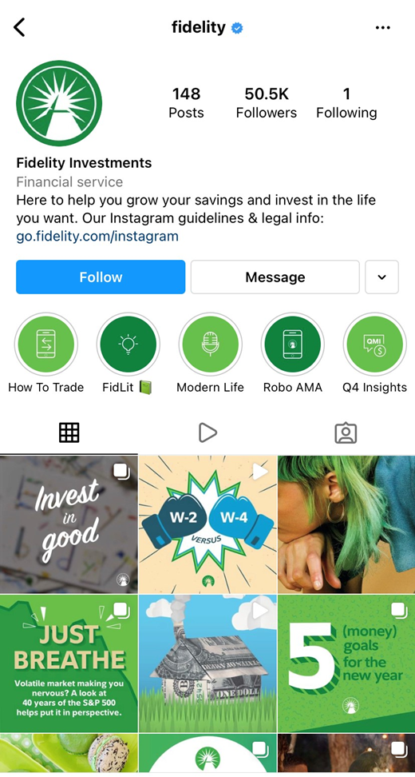
TikTok
Explore
more!
Instagram
Images are for Illustrative purposes only.
Notes:
For those of you who can’t wait until next week, here’s a way to explore a little more:
Check out Fidelity’s Instagram and TikTok accounts. There’s lots of quick tips and simple explanations of financial concepts. This is the kind of thing you’ll be reviewing in Module 5, so this is a great place to get some inspiration!
I so look forward to embarking on this journey with you! I’ll see you next week!

Slide 31

Investing involves risk, including risk of loss.
The third parties mentioned herein and Fidelity Investments are independent entities and are not legally affiliated.
Fidelity Brokerage Services LLC, Member NYSE, SIPC, 900 Salem Street, Smithfield, RI 02917
© 2022 FMR LLC. All rights reserved.
1014632.3.0

