Slide 1
Facilitator Guide
MODULE 04: BOOST YOUR PLAN
  It’s time for you to lead Module 4 of “Your Money Adventure.” This module is all about investing. This module will involve a lot of demonstration and interaction so you’ll need to be familiar with the objectives of the activities throughout this module before facilitating. You’ll also be sharing your screen quite a bit (and not just the slide deck) so you may want to prepare your own “cheat sheet” with the steps outlined on the slides or use the facilitator guide. Make sure you have a stock research page open ready to go before the start of the module. Many of the same guidelines you followed for the first few modules are true for Module 4, so you’ll see those guidelines below.
  You’ll see speaker notes on each slide that read like a script, but we encourage you to ad lib, put it in your own voice, and (*very importantly*) don’t read this word-for-word (that’s a way to lose the teens quick!).
  Sprinkled throughout the speaker notes are bracketed Facilitator Notes that we’ve left for you. These notes offer extra context for the slide, but you should not read those aloud while facilitating.
  We highly recommend you practice each module aloud before delivering it to the teens, especially because there are places where you need to add a personal story/example. This practice will help you connect to the message and deliver it authentically.
  On slide 5, you’ll find timestamps for how long each section of the module should take. Keep track as you’re presenting to see if you are too far ahead or behind. If you are, make an adjustment.
  We’ve also found that facilitators who use dual monitors have better engagements during virtual presentations. Put the deck in play mode on your second screen and share that screen. Then, have your speaker notes on your main screen where your camara is. Move the speaker notes to as close to the top of the screen as possible so you can maintain eye contact while presenting.
  Throughout the modules, you’ll be sharing your screen, sending the teens to breakout rooms, using the poll and white board features, and managing the chat. Make sure you are comfortable with all of these interaction tools.
  We know teens can be intimidating but think about how THEY are feeling – finance is intimidating...money is intimidating! Be empathetic to that. Take your time with these concepts and show them this stuff doesn’t have to be as inaccessible as they may think.
  You’re not a regular facilitator, you’re a cool facilitator...WE know that, but teens don’t. They don’t think you’re cool. And that’s ok! Lean into it. Don’t be afraid to geek out a bit. Finance is your jam!
  Start strong. You set the tone for the entire curriculum on day one – really in the first 30 seconds on day one. Especially when you have to delivery virtually, YOU will need to bring the energy to their screens through your voice, your gestures, and your engagement with the material and to the students.
  Every audience, whether they’re adults or teen, will pay more attention to what you say if you to show passion and enthusiasm for the topic you’re presenting on. Tap into the awesome fact that you get to help young people on their road to financial success! Now THAT’S something to get excited about! Let your enthusiasm and excitement be infectious! It will carry you a long way.
  Hide or delete the facilitator guide before facilitating the module.

Slide 2

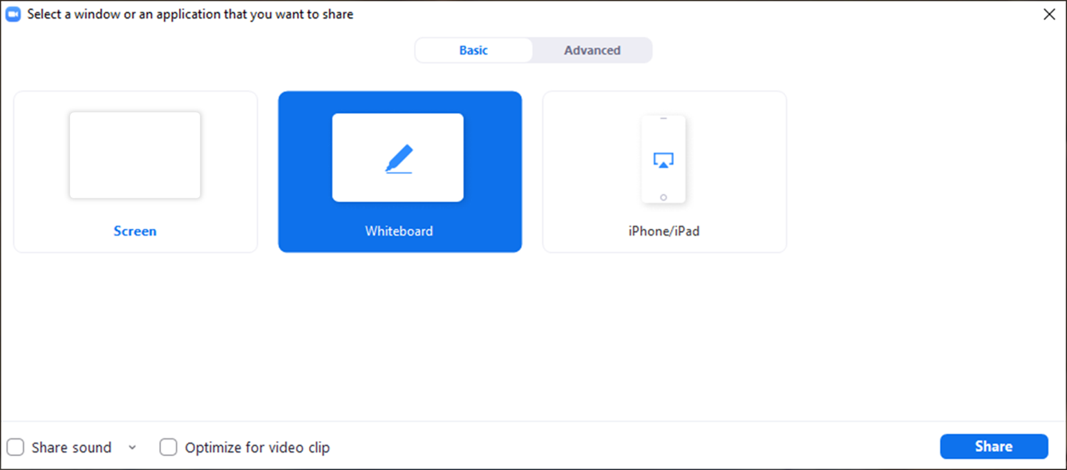
Facilitator Guide
MODULE 04: BOOST YOUR PLAN
  Tech Considerations:
  Whiteboard
  Using the Whiteboard: To use the whiteboard function in zoom you select “Share Screen” and then select the “Whiteboard” option in the pop up. Once the whiteboard opens select “Text” and you will be able to type directly onto the whiteboard.

Slide 3
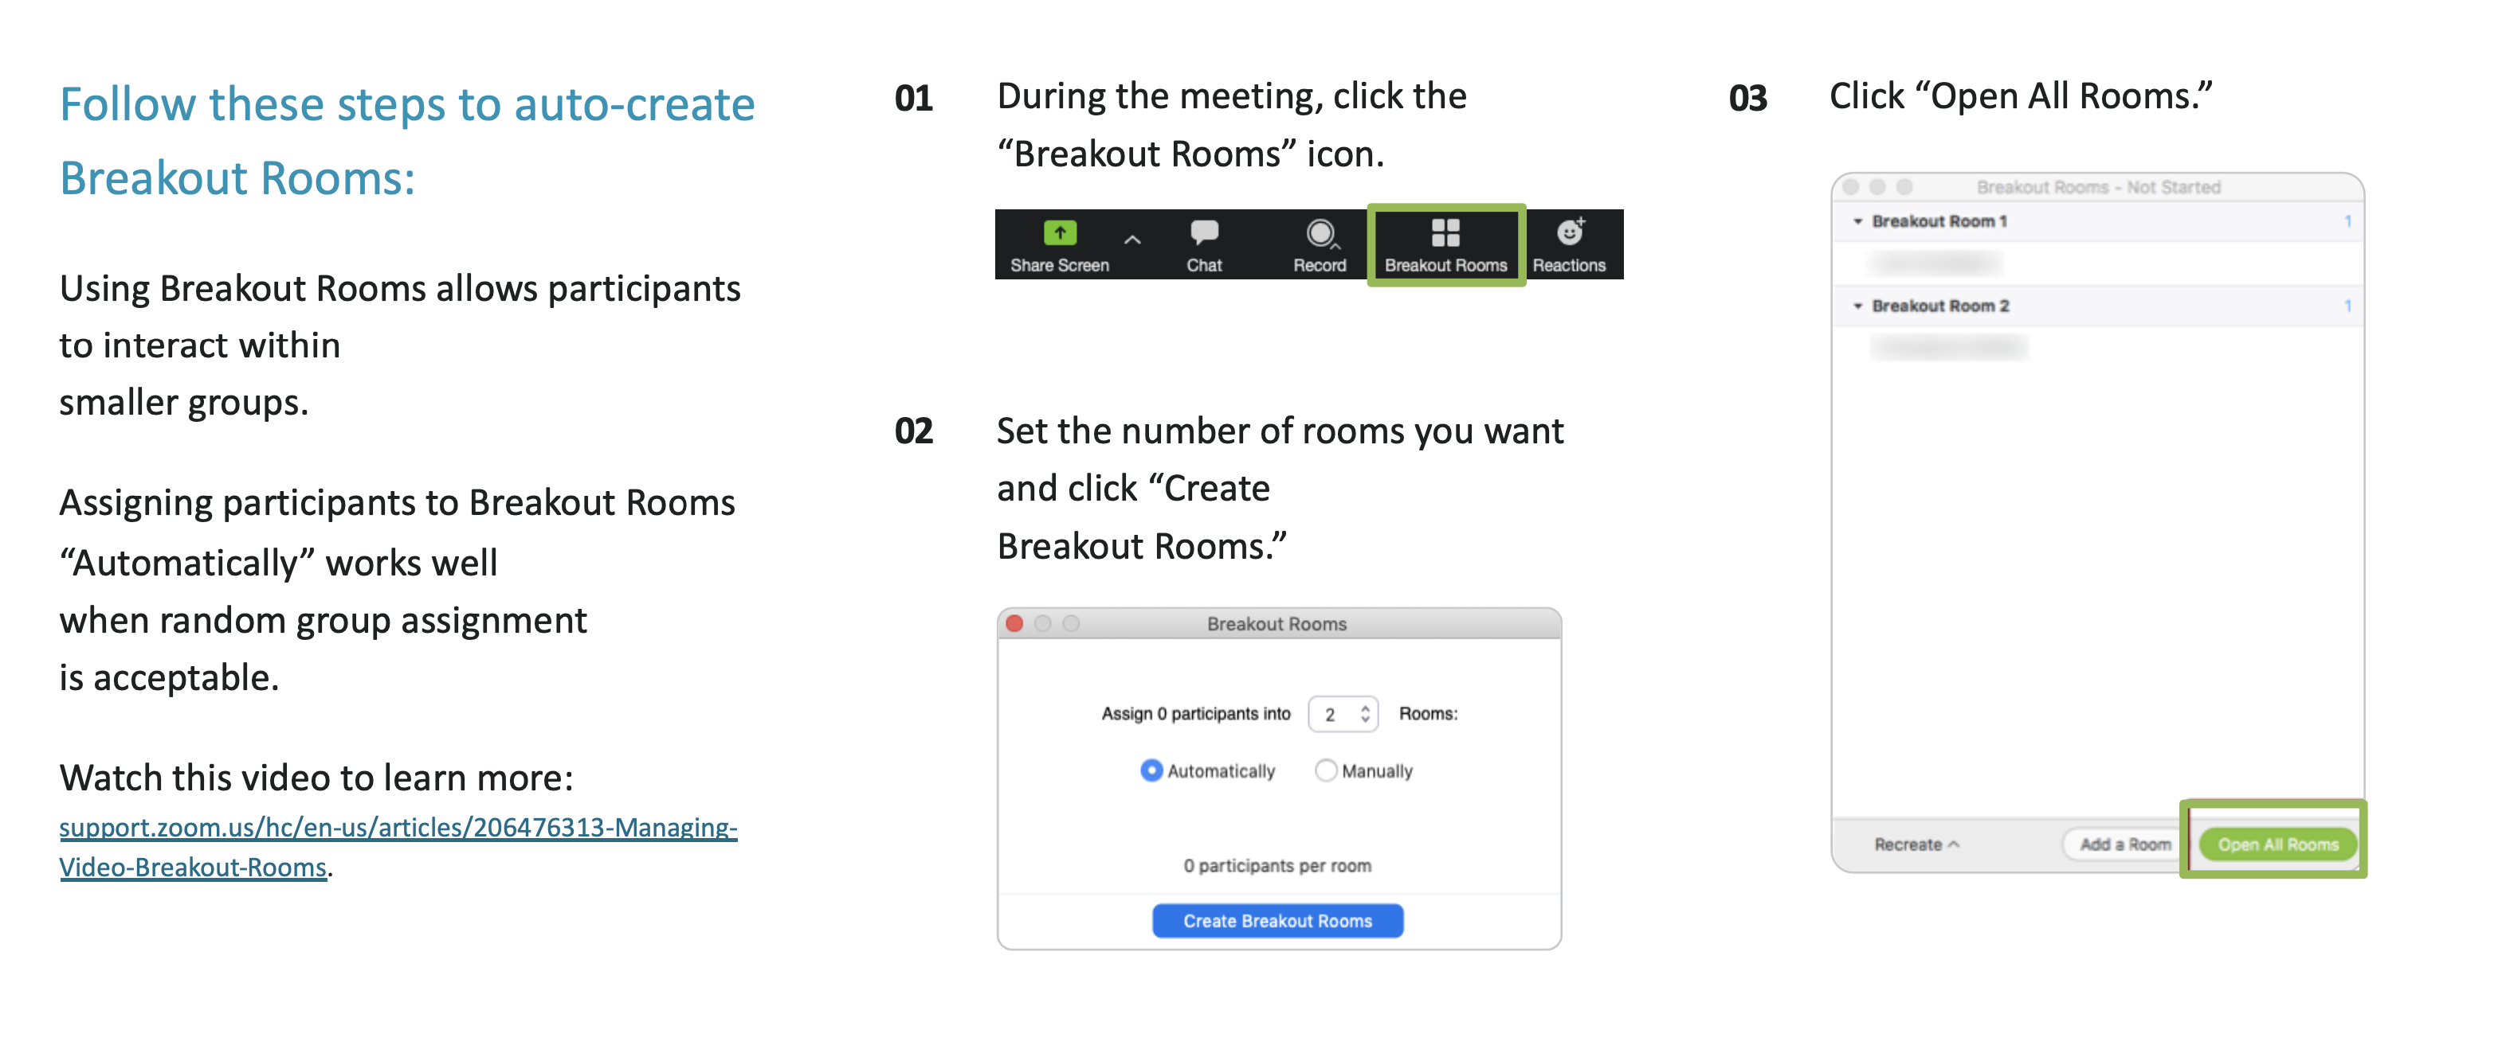
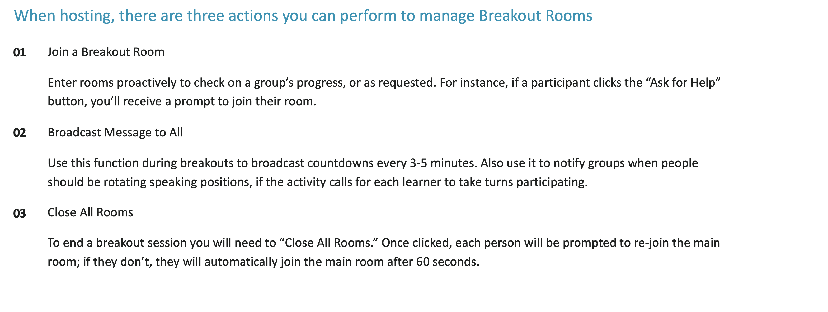
Facilitator Guide
MODULE 04: BOOST YOUR PLAN
  Tech Considerations:
  Breakout Rooms
  In order for breakout rooms to be enabled you have to be the host of the meeting. So that’s the first step, make sure you are assigned as the host or the co-host of the session.
  Assign 4 students per room with a minimum of 3 students if necessary.

Slide 4
Timing Breakdown
MODULE 04: BOOST YOUR PLAN
Section | Duration |  | Section | Duration
Introduction: Welcome back + Recap | 1m |  | Risk | 2m
Icebreaker – Investing questions | 2m |  | Deeper Example: Intro + Facilitator demo | 10m
When you hear “investing”... | 2m |  | Small group stocks activity | 7m
Changing the perception + What is investing? | 2m |  | Small group debrief | 5m
Risk & Reward: Compound interest | 2m |  | Setting Yourself Up: Good investing habits + Achievement unlocked | 2m
Group exercise: Compound interest | 2m |  | Close: Knowledge check | 3m
Investing about risk + Market volatility | 3m |  | Explore more + Capstone teaser | 1m
Investing Intro + Group activity | 7m

Slide 5

Welcome!
I’m excited
you’re here!
01 Camera on if you can
02 Mic on mute until
you're ready to share
03 Grab a pen and paper
or open a new document
Notes:
[Facilitator note: Log on a few minutes before the start of the module. As students are joining the Zoom, you’ll want to give them instructions of how to prepare. This moment of interaction will both save time later and create an engaging/inviting atmosphere]
Welcome back everybody! If you can, we’d love to have you on camera for this workshop and your mic on mute until it’s time to share! [Facilitator note: It’s best to make “camera on” optional and not try to pressure students to come on camera]
While you’re getting settled in, make sure to have a pen and paper handy, or open a new document on your device. We’ll be doing a few exercises today where you’ll need to write out your answers.

Slide 6


Education Content Created By
Your Money Adventure
04 Boost your plan
Speaker Name | Speaker Title
Date
Notes:
Welcome to week 4 – Investing! This is an exciting week! I’ve been hinting at it, offering a few sneak peeks at what’s to come, but today we’re really gonna get down to the business of investing.
What I love about our investing discussion today is that it not only gives you tools to help you reach the financial goals you outlined in week 1, but what you learn today is something that could truly improve your life.

Slide 7




05
01
Build your roadmap
Strategy for spending smart
Adventure awaits
Financial know-how in action
Let the adventure begin
Short-term / long-term goals
04
Lay of
the land
Savvy saving habits
Boost
your plan
Jump into investing
Notes:
We’ve talked about saving, we’ve talked about smart spending, and all those skills will help you become smart investors. You spend smart and you save so you can have some left over to invest. Why? Because there’s so much earning potential when it comes to investing!
So today you’re going to learn the basics of investing and see what’s possible when you’re a savvy investor.

Slide 8
Experience
Investing
Buying Real Estate
Why Prices Change
Interests
Crypto
Stocks
Stock Market
NFTs
Investing
Questions
Notes:
[Facilitator Note: This is a generic list and will need to be updated, based on the questions the teens have]
What are some questions you have about investing? Let's create a list:
[Facilitator note: You’ll want to categorize and share what you found both in terms of experience (e.g., “Looking at your experience with investing it sounds like some of you are brand new to this while others have heard your parents talking about it, but that’s it”) and interests (e.g., “There seems to be a lot of interest around X and Y. While we won’t quite get to Y we will be covering X today. And if we have time at the end, I’m happy to chat about Y”). Acknowledge what you’ll be able to cover but note there will be time for questions either today or next time and you’d love to talk more about their experience and interests].
Anything missing from this list?
There’s a lot to cover and (I’m glad to see) a lot of interest around this topic so let’s get into it.

Slide 9


What images come to
mind when you hear
the word “investing”?
Notes:
What do you think of when you hear the word “investing”? Who do you picture when you hear the word investor?
[Give students a chance to respond. This is an opportunity for some good discussion. If they’re hesitant to come off mute, invite them to put their answer in one word in the chat and then you can narrate and discuss the terms they put there. We’d expect them to say things like – Wall Street, the Monopoly man, men in suits, the stock market, dollar signs, etc. Respond to their thoughts (e.g., ”Yeah, the idea of investing can seem overwhelming and it’s hard to know where to start,” “We’ve been fed a pretty stereotypical view of what an investor is, for sure – guys in suits”)]
For a long time people thought investing was “complicated” and for “guys in suits,” and that was true for awhile, but things have changed...
And your generation is at the forefront. When I look at all of you here, That’s what an investor looks like to me. And I’m not the only one who thinks that...

Slide 10

FINANCE | UPDATED 2:17 PM EDT
SHARE
•LIVE
SHARE
Gen Z Priority:
Saving for Retirement
Gen Z: A new force in investing
FINANCE
5 HRS AGO
UPDATED 5:23 AM EDT
*
          Gen Z might be on their way to becoming one of the wealthiest generations
          Gen Z: Reimagining the rules of personal finance
For illustrative purposes only
Notes:
A quick look at the headlines and you’ll see Investing and Gen Z all over the place!
Gen Z Priority: Saving for Retirement
Gen Z – a new force in investing
Gen Z – reimagining the rules of personal finance
Gen Z might be on their way to becoming one of the wealthiest generations
Let me share the key theme from the news...Its still early in the game of wealth generation but more Gen Z’ers have exposure to the stock market and have started saving for retirement earlier. These are important factors for wealth accumulation. Sit with that thought for a second. That’s a pretty powerful thought. And they are talking about you.
So let’s throw out the old idea of what investing is and what an investor looks like. Let’s shift from tricky to tempting, from complex to common ... and replace those suits with sneakers.

Slide 11






Notes:
But what is investing, really? At its core, investing is about growing your money. If saving is about putting aside the money you worked for, investing is a way to make your money work for you. The money you put aside with investing, could actually grow! You put your money to work in a stock, bond, or other financial instruments with the potential of making a profit.
When we hear from young people about finance, that their goal is financial freedom. Now that can mean different things to different people, so we dug a little deeper. They told us they didn’t want to live paycheck-to-paycheck, they wanted to be able to afford not just the basics but extras, and they wanted to not have to stress about money all the time.
Investing has the potential to make that life possible because investing gives your money the potential to grow. It’s the thing that can give your finances a boost and set you up for financial success later in life.

Slide 12

Returns from investing can help make
your money grow
Notes:
And where does that boost come from? Compounding returns. When you invest money towards long-term savings, that money can grow in value. It’s added money on top of the amount you put away! And then over time, even that cumulative effect can increase in value growing your earnings more and more! That’s what I mean when I say your money works for you when you invest.
Now you may not be thinking about the long term, but even if your dream is to start a successful business or dabbling in crypto, become a millionaire over night, investing that money so it has the potential to grow through compound interest is a smart idea.
And the best part about compounding growth: teens like you have the biggest chance to see its power. Time is on your side! And time is the biggest factor when it comes to growing your investments.

Slide 13
The earlier an investor begins, the greater potential for growth
$1,200,000
$1,068,000
$1,000,000
$800,000
$600,000
$505,000
$400,000
$200,000
$0
25
30
35
40
45
50
55
60
65
Investor A
Starts investing at 25
$5,000/year for 40 years*
Investor B
Starts investing at 35
$5,000/year for 30 years**
For illustration purposes only
Although investing and compounding may help you grow your money, please remember that investing involves risk. You could lose money, investment returns are likely to fluctuate, and investing on a regular basis does not ensure you’ll make more money. These examples are hypothetical and don’t reflect the performance of any specific investment.
*This hypothetical example assumes the following: (1) a $5,000 contribution is made on January 1 and every year from age 25 to 65 and age 35-65, respectively. It does not take into account the Secure Act 2.0 indexing of catch-up contributions.
(2) an annual rate of return of 7%, and (3) the ending values do not reflect taxes, fees, or inflation. If they did, amounts would be lower. Illustrations with a 7% rate of return also come with risk of loss.
**This hypothetical example assumes the following: (1) a $5,000 contribution is made on January 1 and every year from age 35 to age 65,
(2) an annual rate of return of 7%, and (3) the ending values do not reflect taxes, fees, or inflation. If they did, amounts would be lower.
Notes:
Let’s consider this example:
Investor A starts investing at 25, invests $5k/year for 40 years.
Investor B waits to invest until 35, 10 years later than Investor A, and invests $5k/year for 30 years, until reaching 65.
Who do you think ends up with more money at 65? If you think it’s investor A, put an A in the chat. If you think it’s investor B, put a B in the chat. [give them a chance to answer]
[Facilitator note: respond based on their guess. If most say A, then “You’re really catching on here!” If most say B, “time is not on the side of investor B.”]
[Click]
Even though investor A invested only for 10 years before Investor B, by investing that $50k earlier than investor B, it’s investor A who ends up with nearly double what Investor B has at 65. THAT’s what it looks like when your money is working for you.
Although investing and compounding may help you grow your money, please remember that investing involves some level of risk. You could lose money, investment returns are likely to fluctuate, and investing on a regular basis does not guarantee you’ll make more money.
1104104.1.0

Slide 14

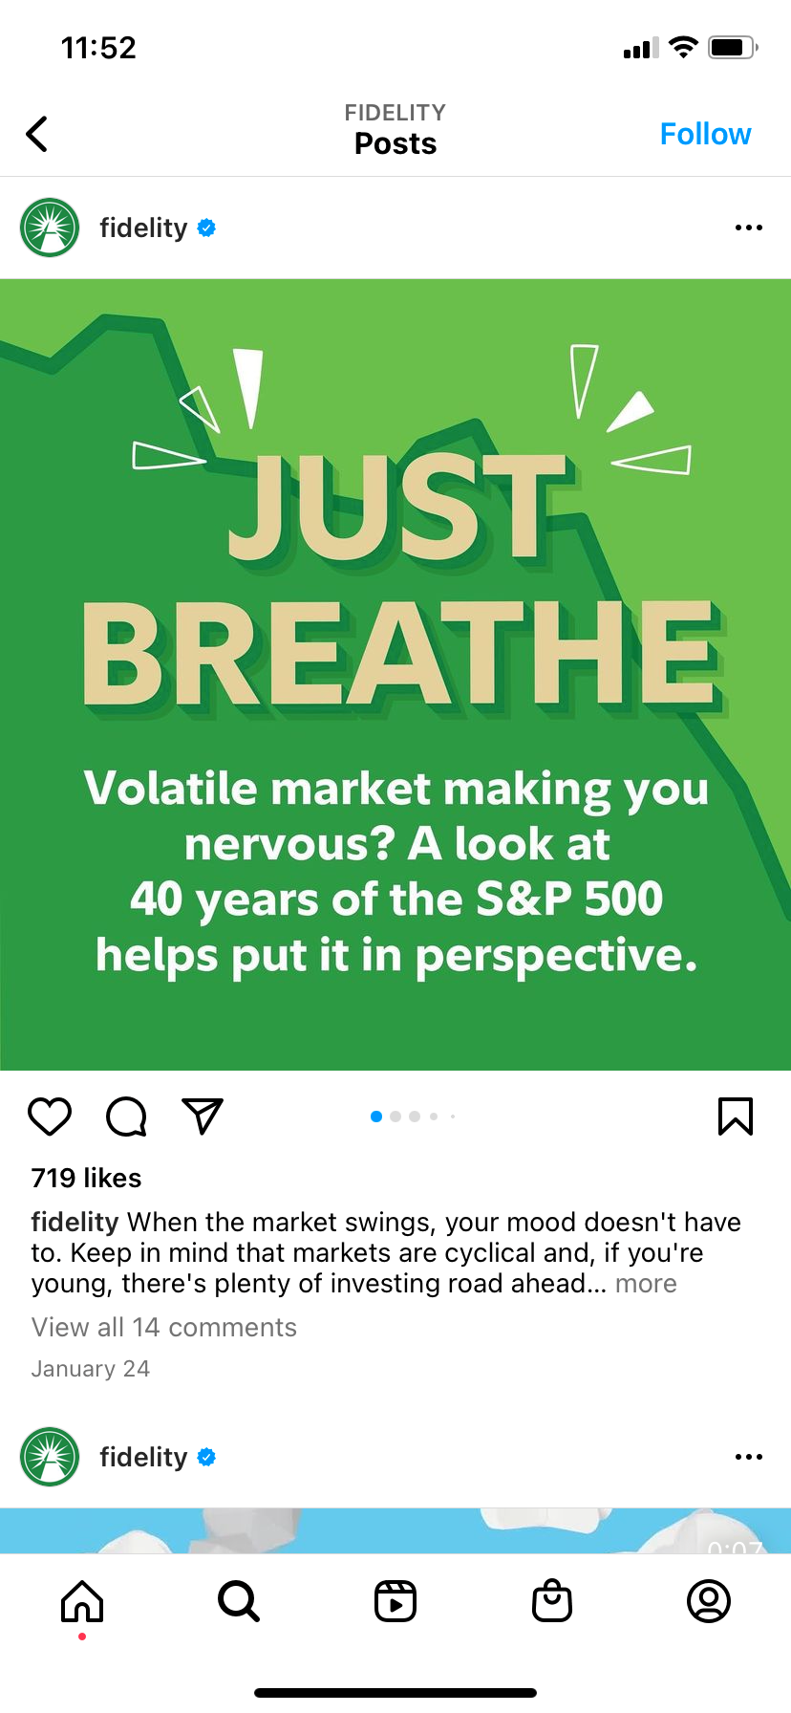
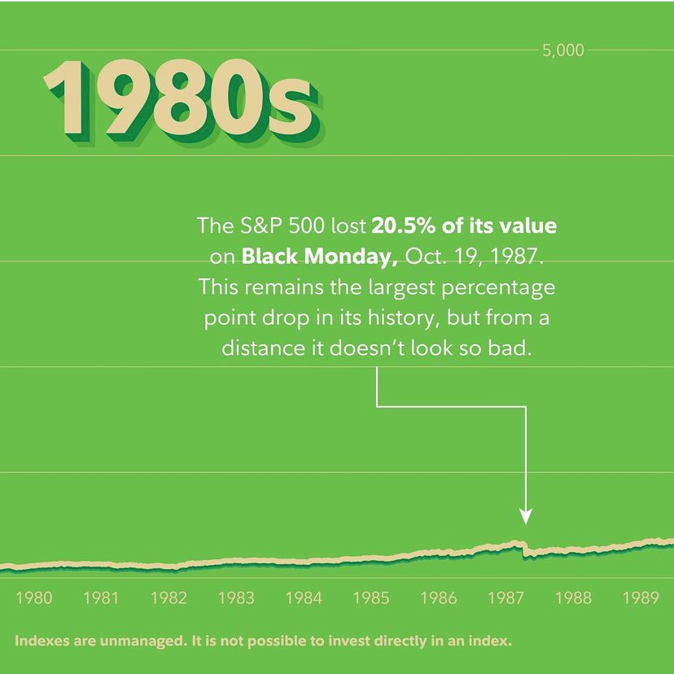
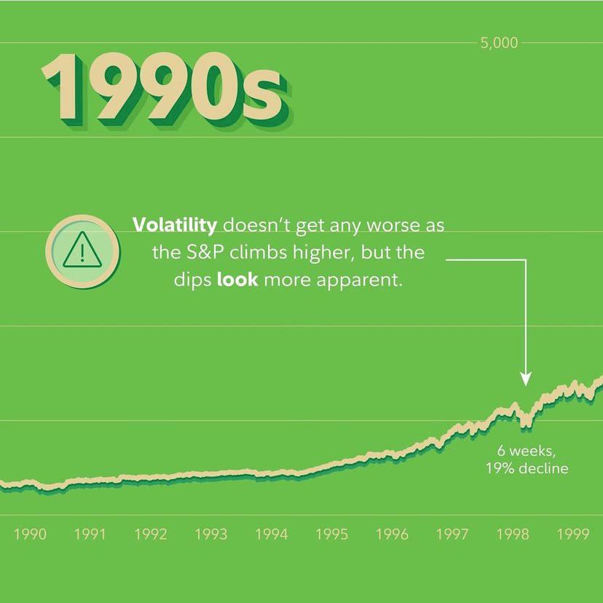
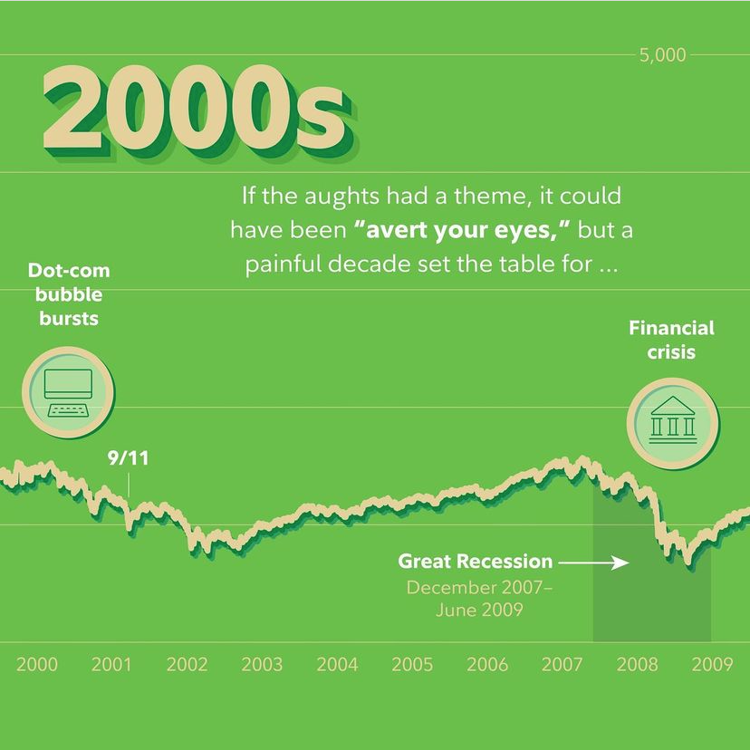
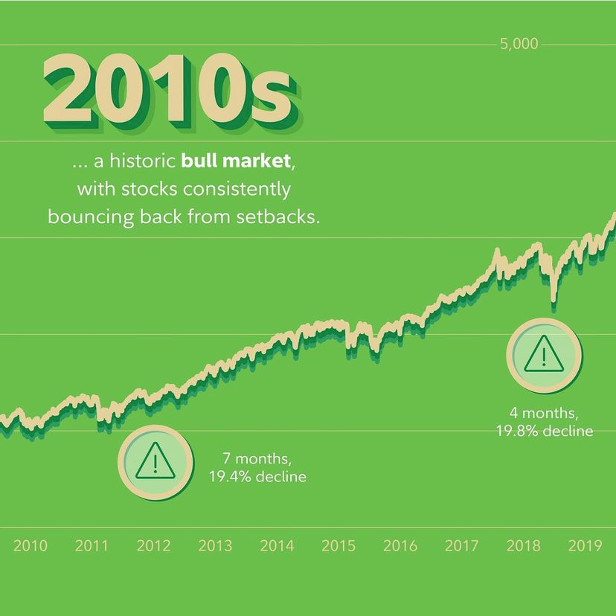
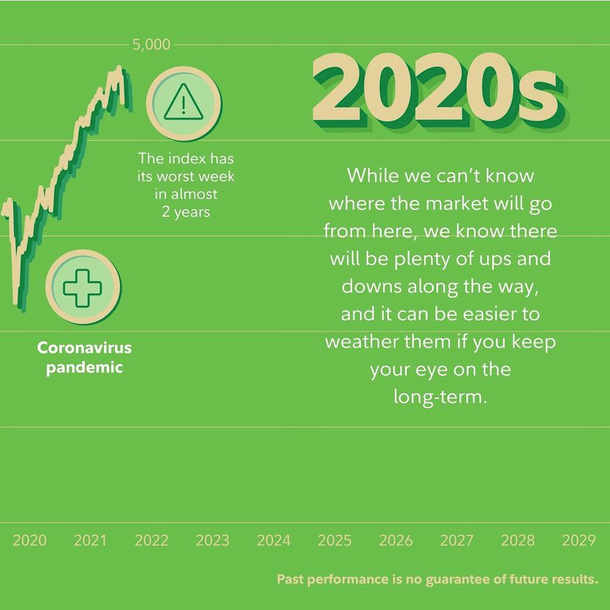
For illustration purposes
IG post: 1012761.1.0
Notes:
If you’re thinking “wait—I could lose money if I invest. I’m out,” hold that thought for a minute.
This is a post from Fidelity’s Instagram page, and it’s worth sharing here. Yes, investing involves risk and it can definitely make you sweat. The market can be volatile and bring on anxiety. Investment value will change by the day, even by the minute. And if you’re involved in investing, there will no doubt be times when your investment value falls.
But you want to know what the most successful investors of all time would say? Just breathe and wait it out.
That’s because people who stick with it over time, and who have a mix of different investment types, generally end up making money.
Here’s a look at the 40-year performance of 500 of the leading publicly traded companies in the US.
We can look at the 80s [Click] then 90s. Things are starting to grow, but ouch – that big dip there had to be felt, [Click] and the 2000s. That’s when we had the dot com bubble burst, and there was also the great recession – this was painful decade, but things started to turn for the better [Click] in the 2010s, and [Click] even better in the 2020s…all despite the fact that we’ve been living through a pandemic.
So if an investor had panicked in the 2000s and took all their money out of investments, they’d have missed out on the growth in the years after.
Even though the stock market is unpredictable, and there will be ups and downs, it can be easier to handle these shifts if you keep your eye on the long-term.

Slide 15



Bonds
Stocks
Real estate
ETFs
An almost endless range of investment types
Mutual funds
NFTs
Cryptocurrency
Cash
For illustration purposes only
Notes:
It can seem pretty intimidating to learn about something new… especially when it seems like there are endless possibilities.
And when it comes to investing, there are so many possibilities…in fact WAY TOO MANY to even list here.
[Facilitator note: Avoid describing unique asset class risk.]

Slide 16
Bonds
Stocks
Real estate
ETFs
An almost endless range of investment types
Mutual funds
NFTs
Cryptocurrency
Cash
For illustration purposes only
Notes:
So we’re going to just focus in on three that you probably hear about in the news all the time.
(CLICK)
Mutual funds, stocks, and cryptocurrency

Slide 17
Bonds
Stocks
Real estate
ETFs
An almost endless range of investment types
Mutual funds
NFTs
Cryptocurrency
Cash
  Money is pooled with
  other investors with
  similar investing goals and managed by a financial pro.
For illustration purposes only
Notes:
Mutual Funds are a collection of stocks, bonds, and other investments all rolled into one. With mutual funds, your money is pooled with other investors with similar investing goals and managed by a financial pro.
In addition to leaving the management to a professional, an advantage of a mutual fund is that it can be made up of a diversified mix of investments. Diversification means that you’re spreading out risk by putting money into a combination of investment types, and/or over a mix of different company types, industries, and business sizes too.

Slide 18
Bonds
Stocks
Real estate
ETFs
  Companies offer “shares”
  of their business to raise $, allowing people to buy and sell them.
An almost endless range of investment types
Mutual funds
NFTs
Cryptocurrency
Cash
For illustration purposes only
Notes:
Next up, we have stocks.
When people talk about ”the market,” they’re usually talking about stocks. The stock market is where companies raise money by selling “shares” of their business to investors. When a lot of people want to buy shares, the price generally goes up.
If the company does well, the shares that people bought in theory will be worth more money. If the company doesn’t do well, the shares they bought in theory will be worth less money.
And sometimes shares are so expensive, you might want to buy just a piece of a share, called a fractional share. Imagine fractional shares this way – you go into a pizza place but don’t want to buy the whole pizza, so you just buy a slice. That’s what fractional shares are. Maybe you don’t have what you need to buy a full share of your favorite company, so instead you can buy a fraction of a share.
A fractional share is just a smaller part of a share of stock. And whether you buy a whole share or a fractional share, you become a partial owner—or stockholder— of that company. Kinda sick, right?

Slide 19
Bonds
Stocks
Real estate
ETFs
An almost endless range of investment types
Mutual funds
NFTs
Cryptocurrency
Cash
  A digital form of currency that’s transferred peer-to-peer through the internet.
For illustration purposes only
FBS does not offer crypto nor provide trading or custody services for such assets.
Notes:
And finally today, there’s Cryptocurrency, or crypto for short. It’s a type of digital currency that’s transferred peer-to-peer through the internet.
Unlike stocks, cryptocurrencies are not backed by any central authority so they are not tied to a company or business. These are decentralized assets meaning they are not controlled by a central bank.
These assets derive their value from things like supply and demand (how much is available and how many people want it), costs to produce it, and competition. Digital assets are highly volatile and are for investors with a high-risk tolerance.
[Facilitator note: Avoid getting into a discussion about crypto, its risk, and/or different types.]

Slide 20



Low
risk
Medium
risk
High
risk
For illustration purposes only
Notes:
And one of the most important things we need to cover today is the topic of RISK. You always assume a level of risk when you invest.
Personally, I like to think of investing risk in terms of adventure. For me, going on a hike is something I’d call low risk. I’m confident I can make it down the trail and back again, and I’ll get to see some beautiful views along the way, but you can’t rule out a chance encounter with a bear or mountain lion.
But going to an amusement park and riding on a roller coaster is medium risk. What if I fall out?! Ok, that’s not likely…and I know I’ll have fun screaming my head off, but I gotta be prepared for some whiplash.
And jumping out of a plane with a parachute— now that’s a high-risk adventure for me!
So, how risky are you? (Ask teens how risky they might be willing to get with their investments?)
There’s no right answer. In investing, we call that your risk tolerance. And what you’re willing to risk can change depending on your age, personality, and life circumstances.
The more risk, the more potential for reward, but there are no guarantees when it comes to investing. That’s because investing is all about putting your money towards something that you think will make money for you in the future, but we can’t know for sure.
Luckily, it’s not like you’ll just make a random guess where to put your money. There’s research and data that can help you make a smart choice.

Slide 21

For illustration purposes only
Notes:
The Stock Market is where many types of company stock is traded, so we’re gonna take a closer look at stocks today.
When you think of stocks you might think of Wall Street, busy traders on the floor, or really complicated images that look like this. Makes you think of the movies, right?
And while the stock market itself is a complex system of exchanges, once you familiarize yourself with the basics, you’re better equipped to venture into the world of investing in stocks.

Slide 22
Notes:
What company stock do you think you should buy? (e.g. Hersey's)
Why do you think its a good choice? (e.g. because its Easter and they will sell a lot of candy?)
What could negatively impact the company? (e.g. a shortage of supplies?)
Take a look at Yahoo/Google/DuckDuckGo/Fidelity to see what the stock price is.
[Facilitator, call out as you see them with an eye toward a company sold on the stock market and one that has been publicly traded for over 10 years, you can narrow it down and let them pick or just pick one from all the options].
Great! Let’s get some information about this company. [Facilitator, you should have your favorite stock research page ready]
What are analysts saying about the company?
[Take them through the website as you research the stock, narrating as you go. E.g., “We’ll enter the company’s name here, but you’ll see each company is represented by a ticker symbol...now let’s see how COMPANY X is performing today. The first thing you see there in bold is...”]
[Walk them through the site, starting with the stuff in bold at the top – what does the color mean, what does the percentage represent?]
[Then go through some of the details – in SIMPLE language define and explain (what it means, how investors use it when looking at stocks, what is interesting about this) as you go. Highlight the following concepts - Bid, Open, Days high and low, previous close, 52 week high and low, volume, price performance. This should be a conversation- offer your own insights (not recommendations) about what you’re looking at, invite questions throughout, and ask questions of them – e.g. why do we think an investor would be interested in knowing the 52 week high and low?]
[Facilitator note: Next 5 slides are intentionally left blank.]

Slide 23
Notes:
So, we have a good sense of what’s going on with this stock today (the current stock price is X). Let’s all write that down.
Now we know that investing can be a long game. So let’s take a look at this stock’s history. We can start with the chart you see here on the website. This shows the stock’s performance over the past year. [make some observations about how the stock has fluctuated and where it is today vs a year ago, if there are any glaring gaps, etc]
Let’s look even further back and head over to the 2, 5, 10 year and/or life of fund.
Right there on the right is this company’s stock performance 10 years ago. The closing price 10 years ago was X. Let’s all write that down,
Ok, let’s do some quick math. Let me open the whiteboard so we can all do the math together [share whiteboard]
We’ve got the closing bid 10 years ago [write it down] and the bid price today [write it on the board].
If we purchased 10 shares of this stock a decade ago, we’d multiply 10 x CLOSING BID and get X. Let me show you a shortcut...all we need to do is move the decimal over to the right one place.
And the current market value of our investment is X so let’s imagine we purchased 10 shares...since we’re multiplying times 10 all we have to do is slide the decimal over and we get Y.
[compare the difference between the two/speak to the gain/loss in value, market volatility and time...]
So what does this all tell us? How much would you have lost or gained over those 10 years? (give them large overview of what looking at the elements highlighted on the stock page and comparing to 10 yrs ago may teach them as they start to dip their toes in the investing water)

Slide 24
Notes:
Alright, time to play around with this on your own. I want you to get comfortable with researching stocks on your own. First, let me share the link to this website in the chat. You’ll want to have this open before I send you into breakout rooms.
[send link to your favorite stock research page]
Everybody got that link open? Great! We just walked through a few of the features on this page and what they mean. What I’d like you to do in your groups is pick one or two of your favorite brands and use this page to do some research. You’ll need to write this stuff down because when you return, we’ll want to know:
1. The name of the company
2. The current stock price (bid) and the cost if you were to buy 10 shares today (easy peasy, just move that decimal over)
3. The closing bid 10 years ago and the cost if you were to buy 10 shares. [If stock isn’t 10 years old, that’s ok, just oldest recorded closing bid]
I’m going to give you 5 minutes. If you’ve got extra time, look up a second company. Make sure you record what you find as you’ll be sharing when you return. I’ll be popping into your breakout rooms, but don’t hesitate to hit the “help” button if you need anything. That’s what I’m here for. Any questions before I send you off?
[Facilitator note: try to hop into all breakout rooms to make sure they understand and are heading in the right direction.]

Slide 25
Notes:
First, let’s hear from you...what companies did y’all look up?
[this could generate some discussion around the variety of companies and types of companies out there...you might call out some of the sectors that you see well-represented in this mix or highlight areas traded on the stock exchange that aren’t there]
Which companies are performing better in today’s stock market than 10 years ago? [invite some discussion around who is performing well and why...share your own insights]
And which of you have companies whose stock is valued less than it was 10 years ago? [invite some discussion around who is not performing as well as it was and why ... Share your own insights].
Did any groups have a big difference in stock value between 2012 and today?
Did any new questions come up for you as you were digging deeper into this stuff? Anything you’re still curious about when it comes to stocks?
As this exercise has shown, stocks can be a great opportunity for growing your money, but can also be risky and unpredictable. Let’s imagine we invest in one of the well-performing stocks...
If you get anything from our discussion about investing today it’s that starting early can really (literally) pay off! So what do you do if you’re ready to invest?

Slide 26
Good investing habits
3
Buy what you know
4
Do your
own research
2
Be a
super saver
6
Keep your cool
1
Start with
a plan
5
Diversify investments
Diversification does not ensure a profit or guarantee against loss.
Notes:
Here are some important habits to form right from the jump. Do these things and you’ll increase your chances of success:
Start with a plan. Take stock of your situation, define your goals, and figure out the steps to get there.
Be a super saver. Save early and save often. Then save some more.
Buy what you know. Stick with the familiar, especially when starting out.
Do your own research. Find a company or investment doing good in the world and research it.
Diversify. Diversify. Diversify. Diversifying the types of investments you make helps reduce risk and helps you stick with your investing plan. Keep in mind that diversification by itself does not ensure you will make money or guarantee you won’t lose money either.
Keep your cool. When markets get challenging, the best investors stick to their strategy.

Slide 27



You’ve finished this
session and earned a
savvy investor pin!
4 / 5
completed!
Let’s collect them all!
?
Notes:
Congrats!
You’ve got the tools to become wise, savvy investors and the know how to give your financial plan a boost!
Now you know investing can be for everyone. You don’t need to be rich, you don’t need to wear a suit, or work on Wall Street. And with the knowledge of a few key concepts, you’re ready to see how you can make your money work for you.
And this can’t be emphasized enough...when it comes to investing, the sooner you start, the more successful you could be.

Slide 28

Cryptocurrency is the least risky type of investment.
True
False
When it comes to investing, compound interest is a way to
make your money work for you.
Knowledge
check
True
False
When it comes to investing, the younger you can start the better.
Answer the following True or False questions
True
False
You can always expect a stock price to increase over the course of a decade.
True
False
Investing is just for old guys in suits... everybody put your answer in the chat
for this one (and you better get it right!)
True
False
Notes:
You have learned a lot today and you’re better prepared to get started in the world of investing. Let’s do a quick knowledge check to see how far we’ve come. Help me answer the following True or False questions [First invite them to come off mute to share their answer, if there’s hesitancy ask them to put their best guess in the chat]:
1. T/F Cryptocurrency is the least risky type of investment
[Click animation]
False, crypto is way up there at the jumping-out-of-a-plane level of risk and it’s the kind where you can’t always be sure your parachute will work.
2. T/F When it comes to investing, compound interest is a way to make your money work for you.
[Click animation]
True, compound interest is the way your money makes money over time, simply by sitting there.
3. T/F When it comes to investing, the younger you can start the better
[Click animation]
True, and that’s thanks to compound interest. Remember, starting at 15 is way better than starting at 25, or 35, or later! And it’s a great way to set yourself up for financial freedom.
4. T/F You can always expect a stock price to increase over the course of a decade.
[Click animation]
False, all we have to do is look back to the early 2000s, remember? That’s why the longer you can stay invested the better as historically things will improve eventually.
5. T/F Investing is just for old guys in suits...everybody put your answer in the chat for this one (and you better get it right!)
[Click animation]
False, you’re all investors in my eyes! And what’s cool about that is how small steps you could take today can help build wealth for tomorrow.

Slide 29

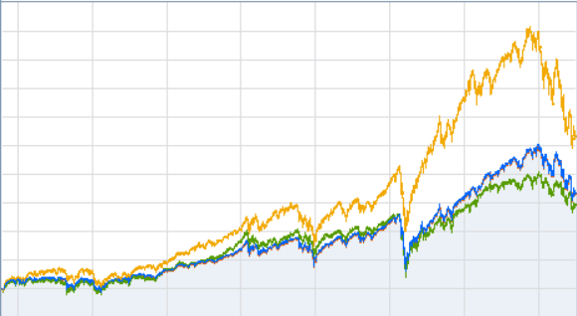
Explore
more!
Career salaries
Pick a few favorite companies and track their stock
SEARCH
Notes:
Are you ready to put your new investing knowledge to work, but still feel a little unsure? Take some time to explore more...
Pick a favorite company or two and start to track their stock using the same method we used together today.
Getting familiar with the way the market moves, how a stock performs over time, and the language of the stock market will get you grounded in the basics so when you’re ready to jump in, you know what to expect.
Now next week, we’ve got big plans in store...

Slide 30
05
01
Build your roadmap
Strategy for spending smart
Adventure awaits
Financial know-how in action
Let the adventure begin
Short-term / long-term goals
Lay of
the land
Savvy saving habits
Boost
your plan
Jump into investing
Notes:
We’ve come a long way over the last couple of weeks. We’re more knowledgeable about saving, spending , and investing and next week we’re going to put our new knowledge into action! I’ve got big plans and can’t wait for you to see what’s in store! Truly, this is a day you won’t want to miss!
I look forward to seeing you all next week!

Slide 31

Investing involves risk, including risk of loss.
Stock markets are volatile and can fluctuate significantly in response to company, industry, political, regulatory, market, or economic developments. Investing in stock involves risks, including the loss of principal.
This information is intended to be educational and is not tailored to the investment needs of any specific investor.
Fidelity Brokerage Services LLC, Member NYSE, SIPC, 900 Salem Street, Smithfield, RI 02917
© 2022-2025 FMR LLC. All rights reserved.
1025088.10.0
Notes:
[If there’s time left at the end, can open it up to questions]

